Slide 1

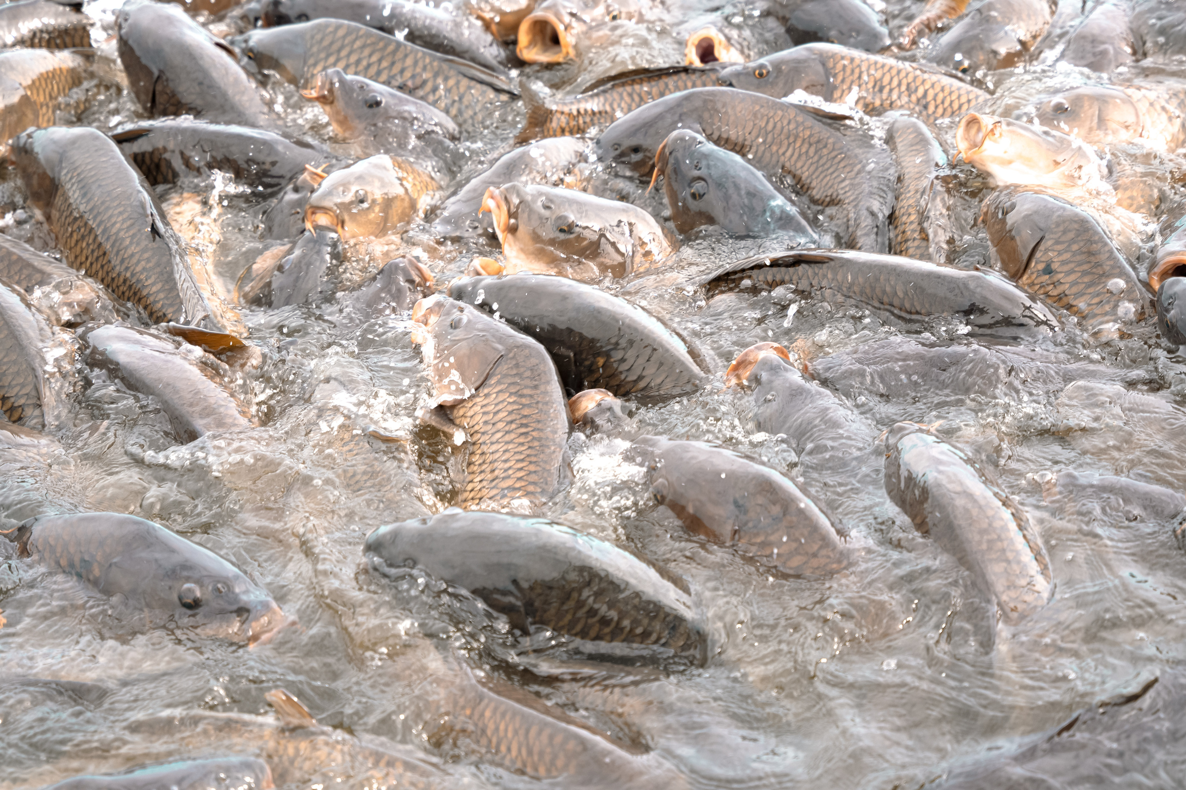

OSU-NU SAFE Progress Update
Advancing Aquaculture In Sierra Leone: OSU & Njala University Partnership For Food Security
Presenter: Dr. Josephus Borsuah
Co-authors: Dr. Scott Stoodley, Dr. Mathew Kpundeh. Karl Rich, Dr. Abu-Barkarr Mansaray, Dr. Karen Hickman, and Ms. Aakriti Adhikari

Slide 2
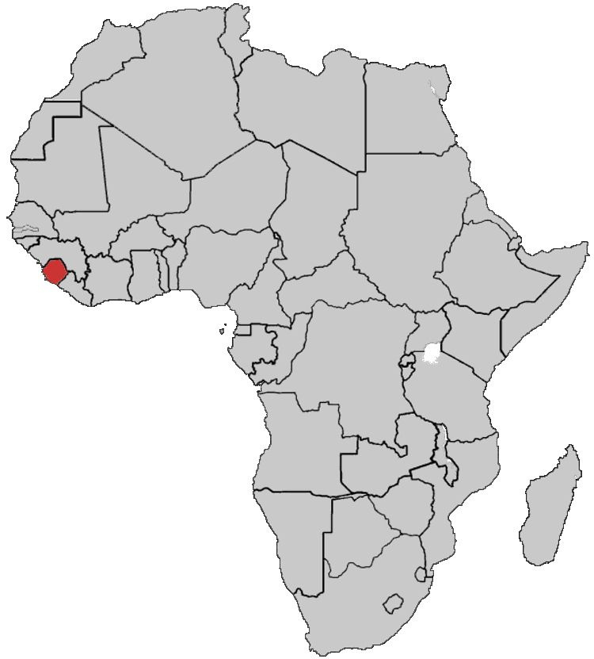

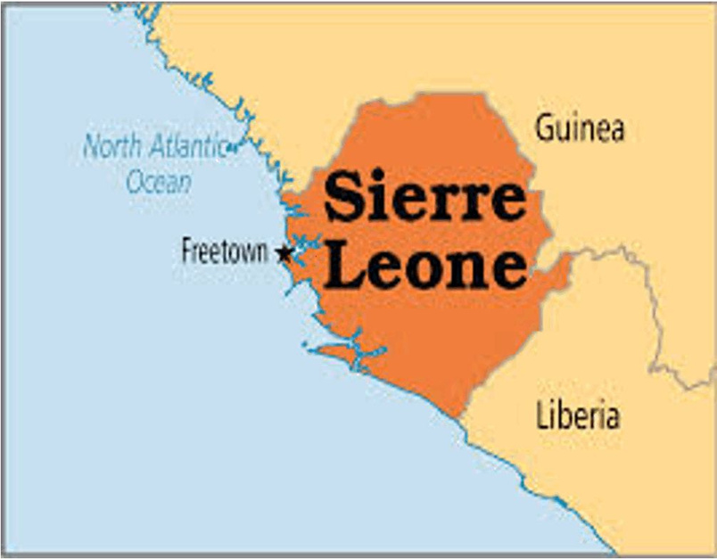
Project Location
Area: 27,699 sq. miles
71,740 sq. km
Population: 8.5 million, 2018 census

Slide 3

Project Background
Sierra Leone's fish stocks are severely depleted
Result:
•Overfishing in freshwater marine environments.
•Limited access to fish protein in local diets.
Causes:
• Industrial overfishing
•Growing population of artisanal fishers

Slide 4
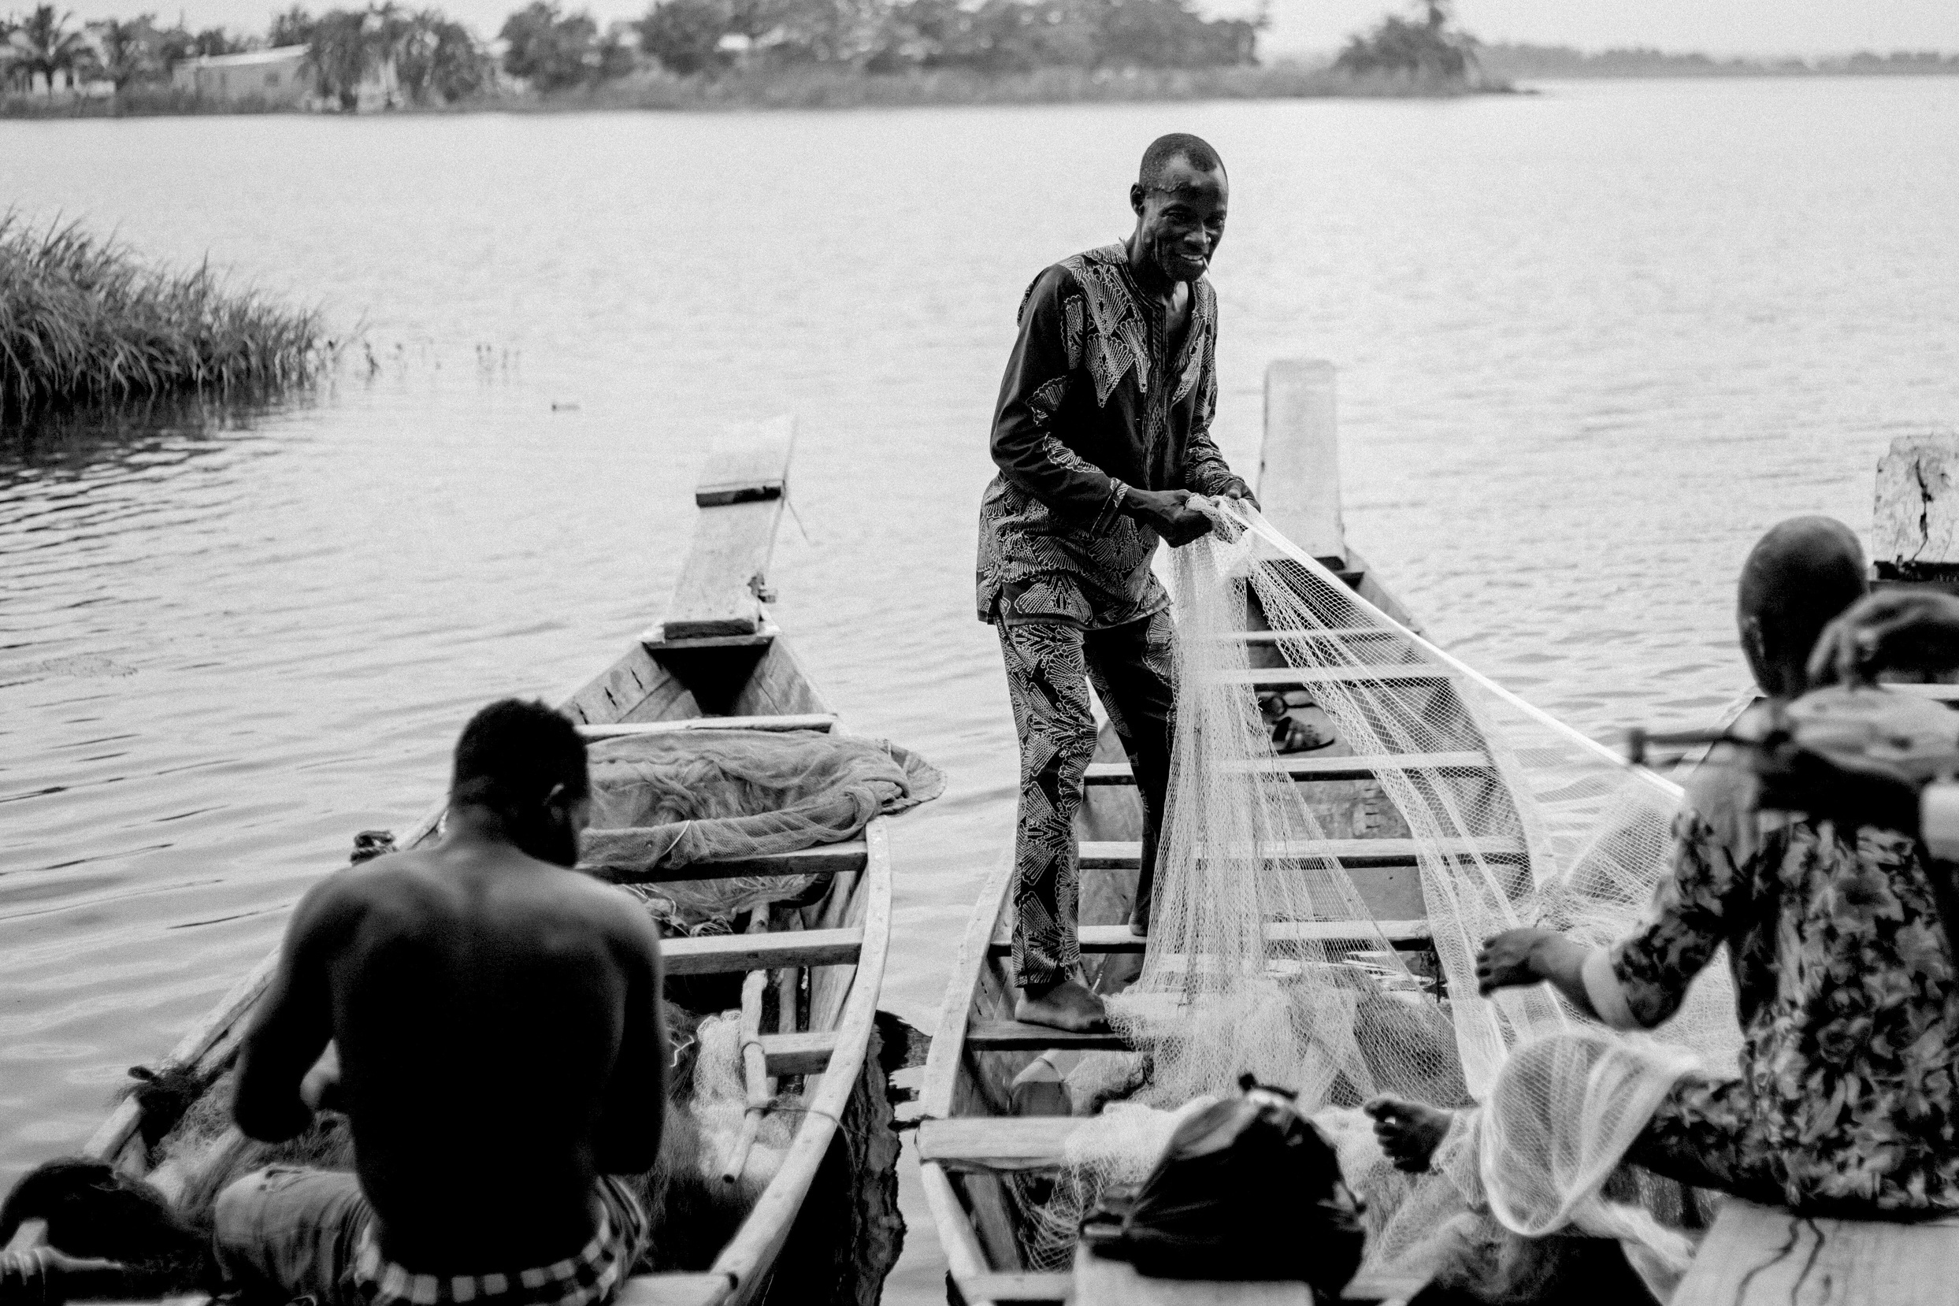
The Challenges
Declining fish catches, impacting food security
Vulnerable groups most affected:
Pregnant and breastfeeding women
Children
Senior Citizens

Slide 5





OSU-NU Aquaculture Partnership
Institution
Goal
Duration
Project Start
Oklahoma State University (OSU) & Njala University (NU) collaboration
Approved Nov 2024, launched Dec 2024
Enhance food security through freshwater aquaculture
5 Years

Slide 6
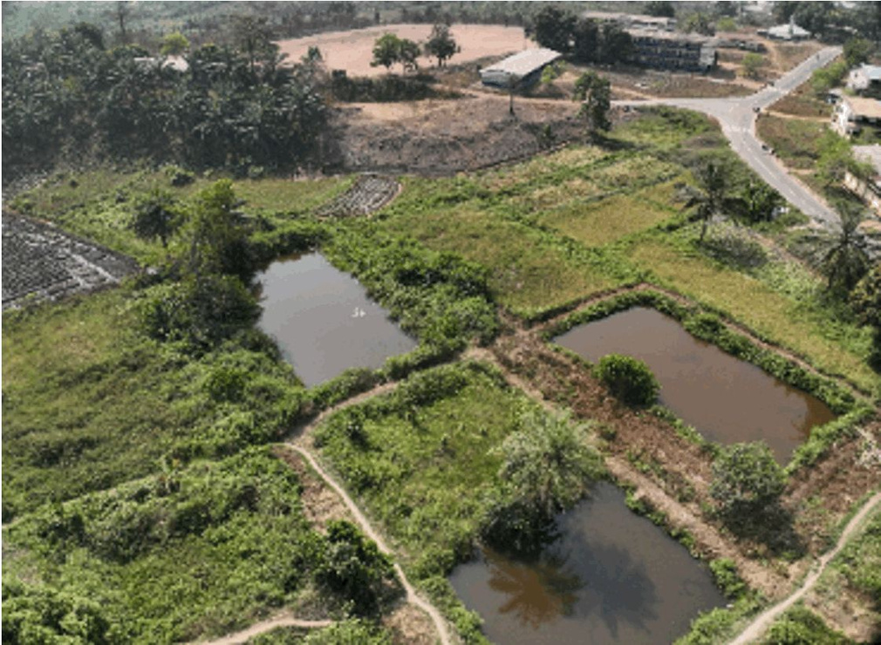
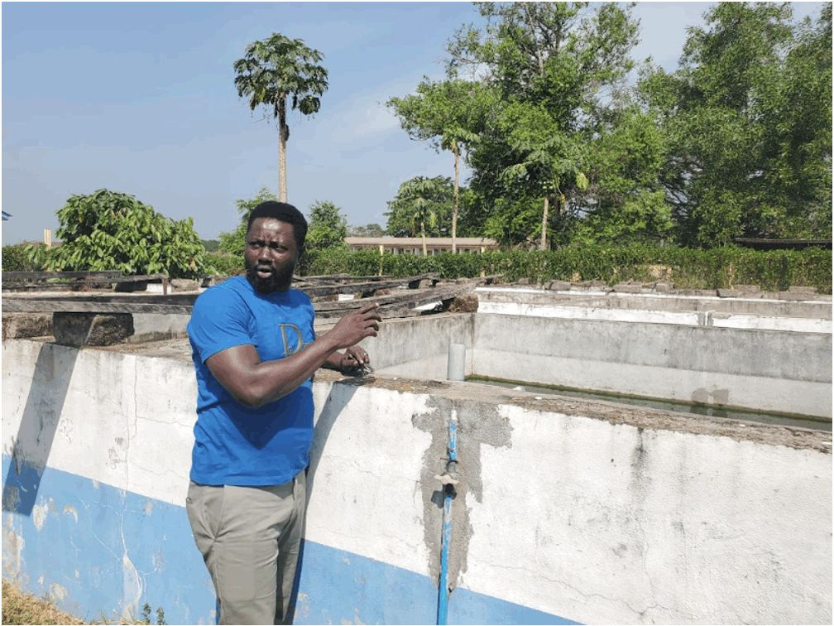
Project Implementation Plan
BO Campus:
Two 4-acre fishponds
Main Campus:
9 concrete fish tanks
Annual Target:
60,000 lbs. of fish

Slide 7
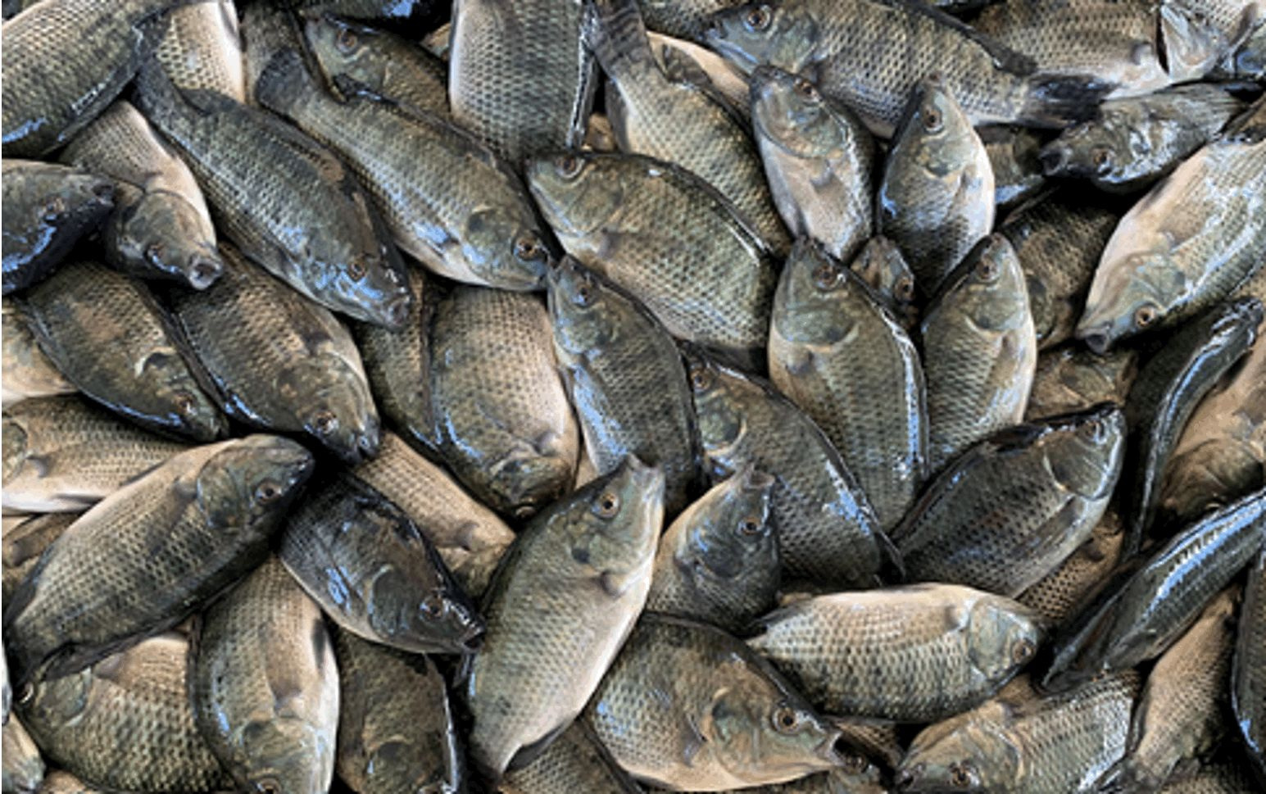


Community Impact
Fish distributed free of charge to underserved communities.
•Target beneficiaries:
  Pregnant women
  Breastfeeding mothers
  Children (Schools)
  Senior citizens

Slide 8



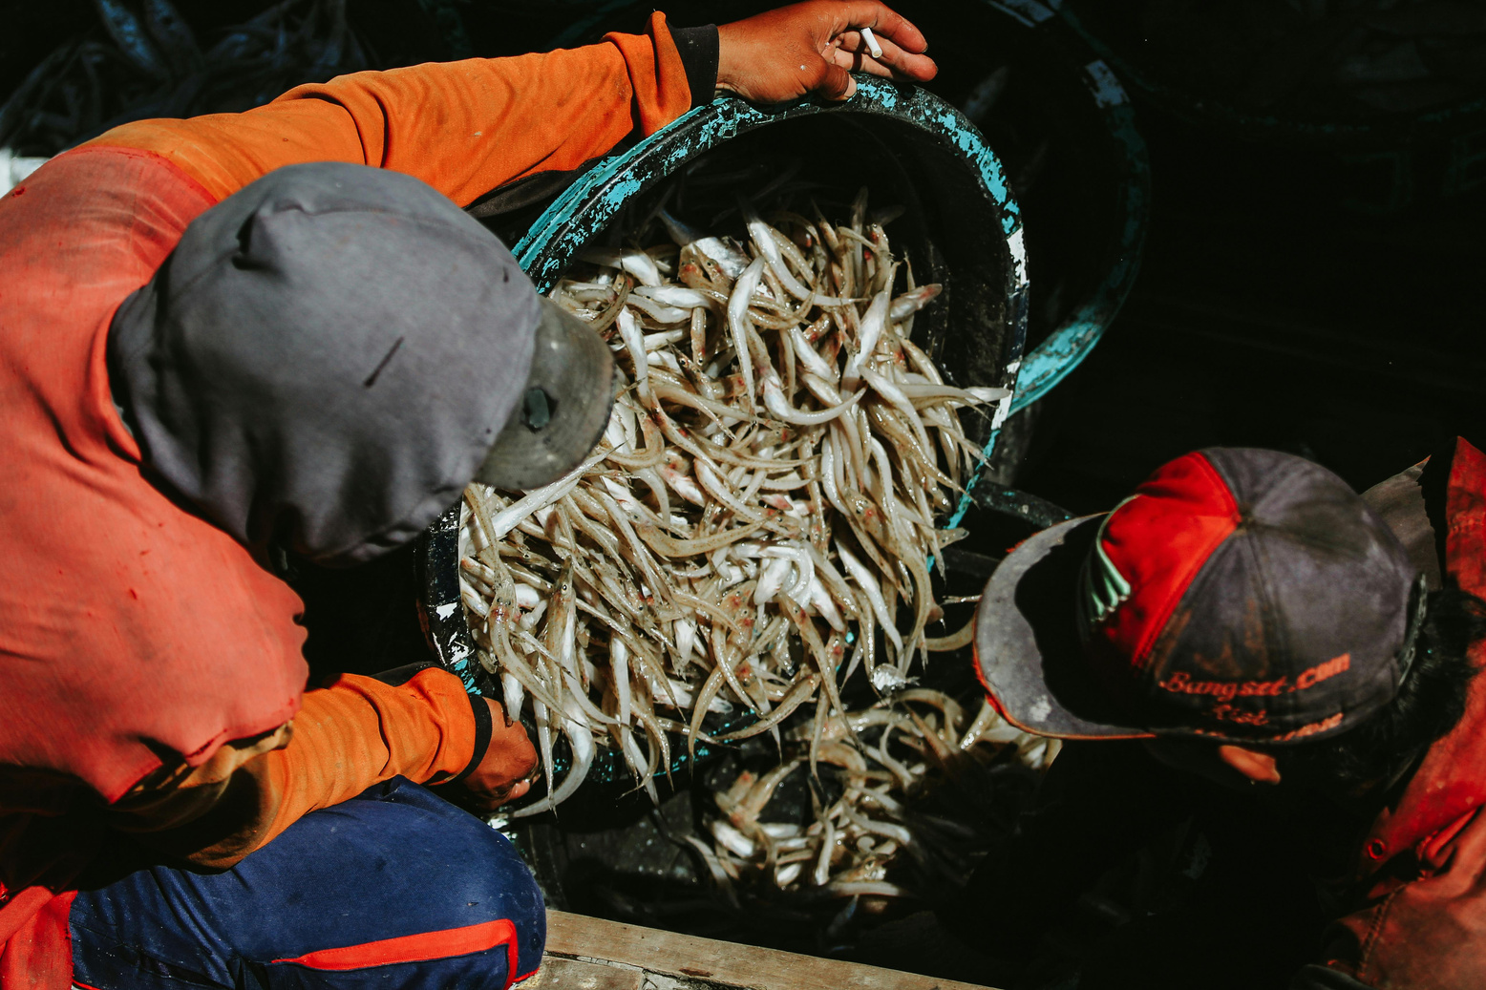
Funding Support
5 yrs Start Up Funds
Cost-share Partner
Milburn Foundation
Njala University
Additional Funding
Sources to be pursued

Slide 9
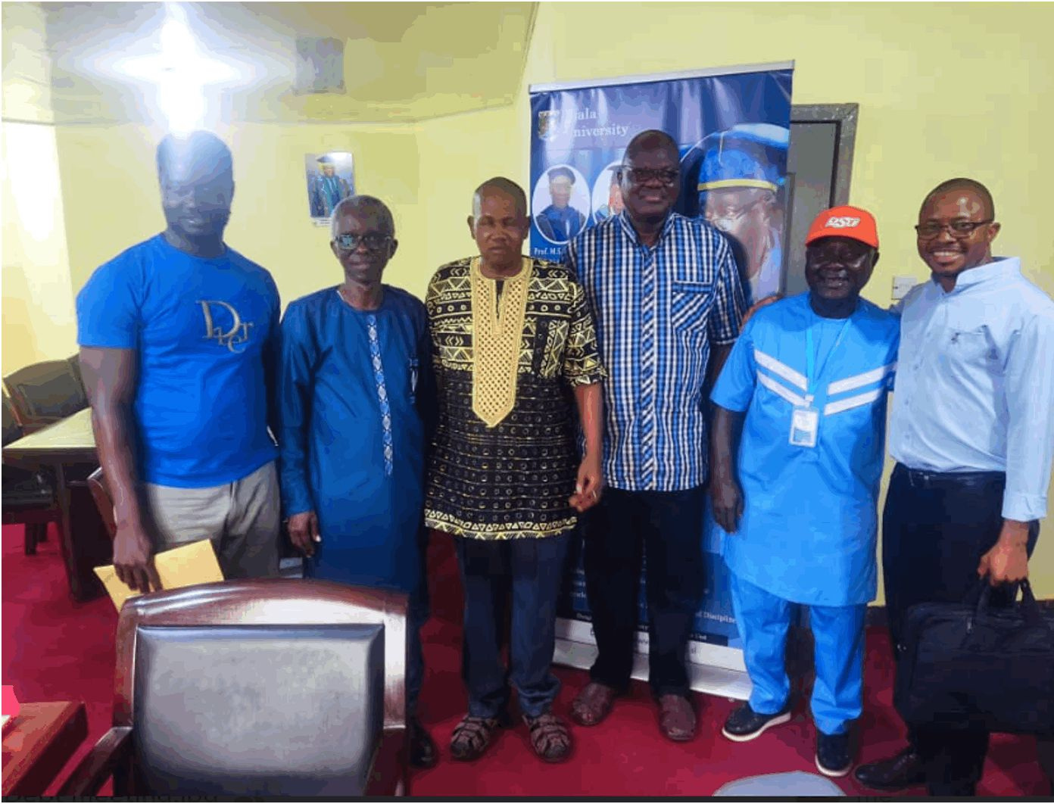
Long Term Goals
Build sustainable aquaculture systems
Collect and analyze aquaculture data
Stimulate commercial-scale fish production Position NU as a regional aquaculture leader

Slide 10


Academic Integration & Global Goals
Supports OSU’s global food security mission
• Opportunities for:
  Student research
  Study abroad programs
  Potential “1+1” Master’s degree track

Slide 11
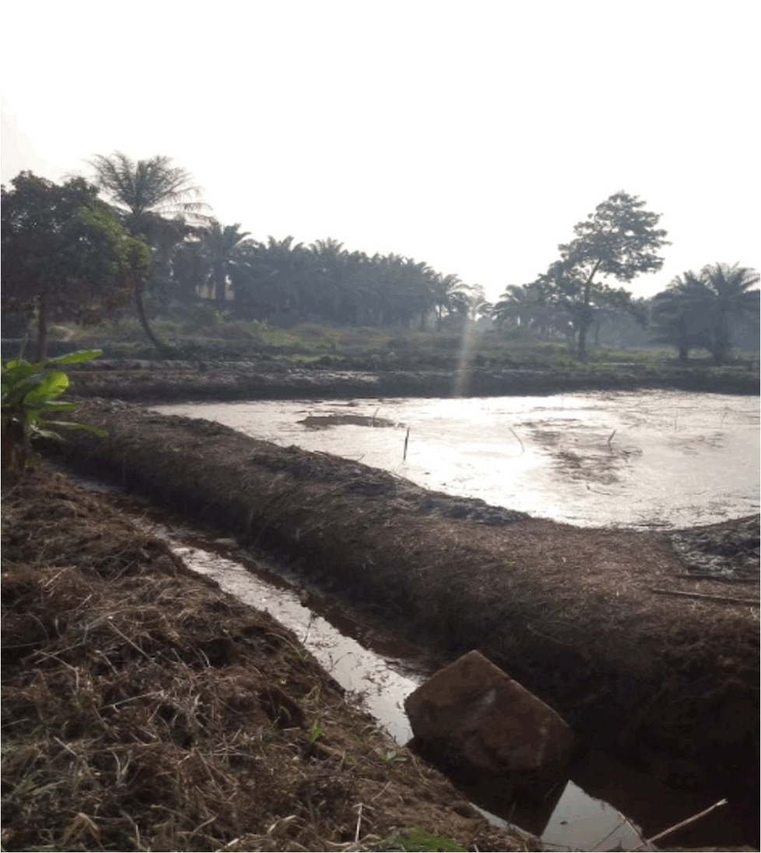
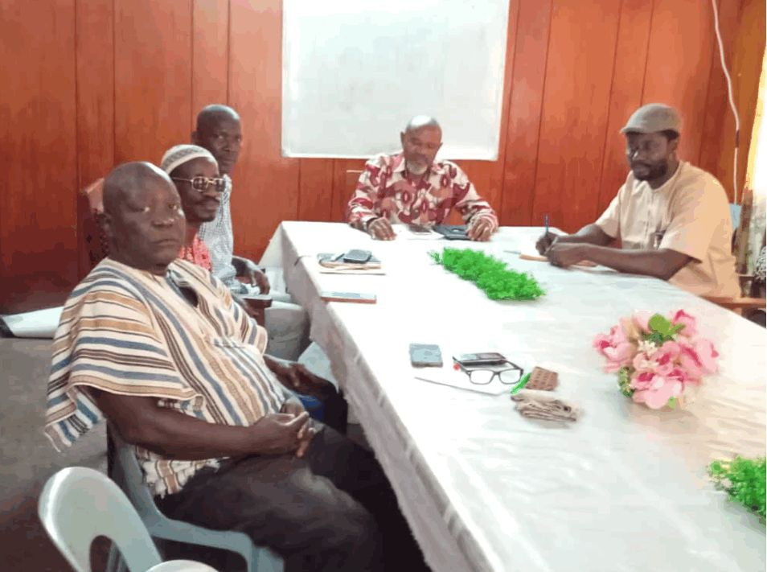
Progress & Next Steps
Current implementation updates
  Complete rehabilitation and stakeholder engagement in year 1
Planned activities for Year 1 & beyond
  Empower communities to start their own project

Slide 12
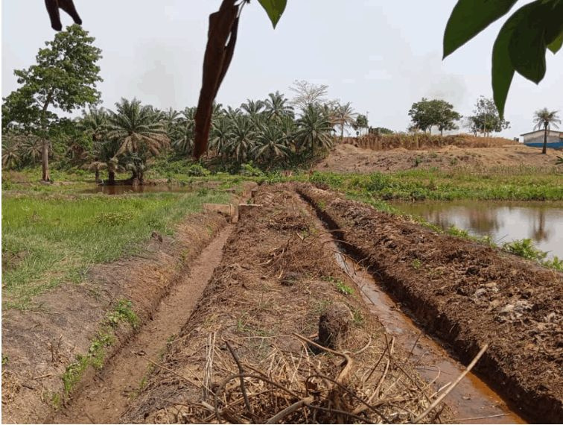
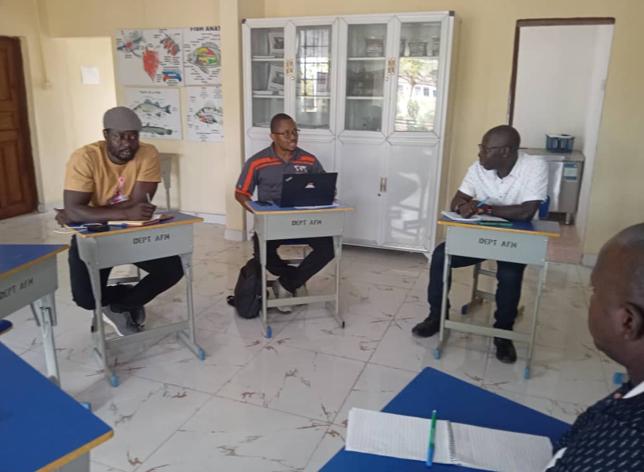
Expected Outcomes
  A vital step toward food security in Sierra Leone
  Strengthening regional aquaculture capacity
  Promoting academic collaboration & student engagement
  Ensuring access to essential protein for vulnerable populations

Slide 13
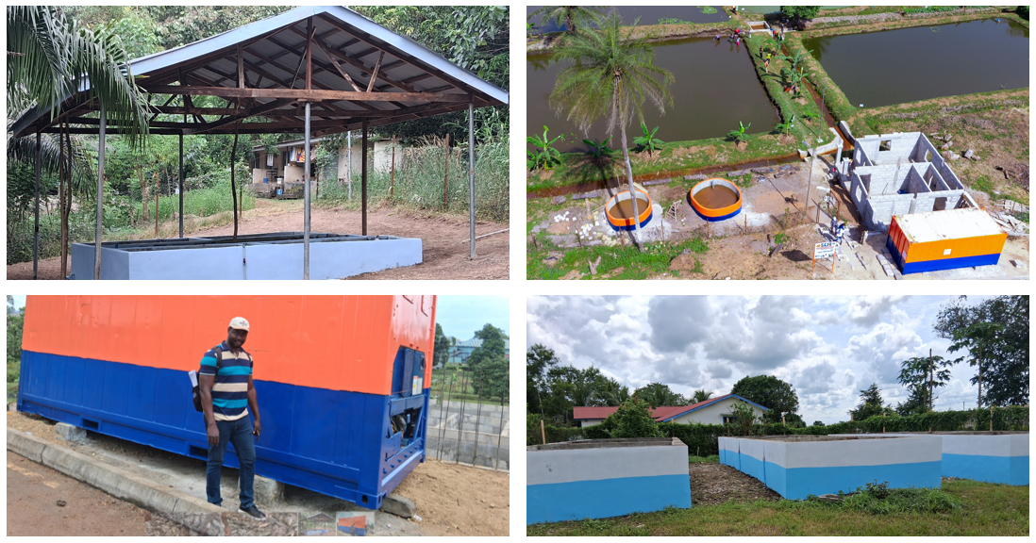
How are we doing?
  6 earthen ponds and 9 concrete tanks rehabilitated and stocked with 60,000 fingerlings in 2025
  1 Hatchery established and the second almost to completions to support fingerling productions for the project
  All capital equipment such as 20ft cold-room container, solar dryer, and fish feed production mild have been purchased

Slide 14
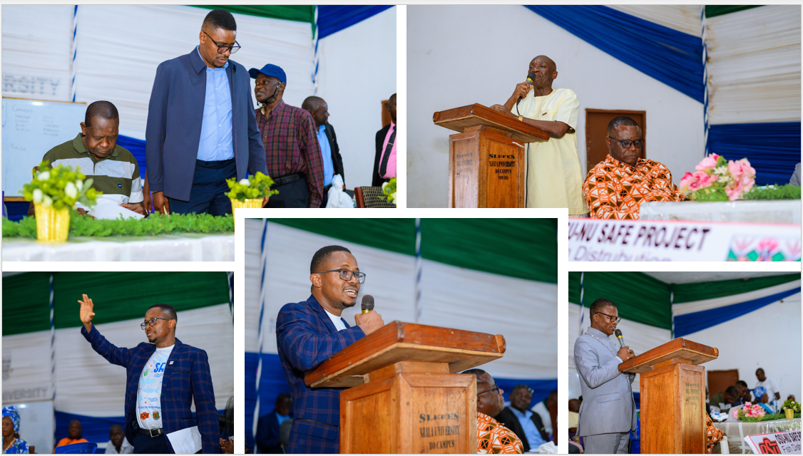
Ceremonial harvest and distribution
  Government; Ministry of Education, Agriculture, and Fishery & Marine Resources
  University stakeholders; Chancelor, NU Vice Chancelor, DVCs both campus, Registrar, and Financial Director
  Community stakeholders includes, chiefs of Tikonko and Kori, reagent chief, and paramount chief

Slide 15
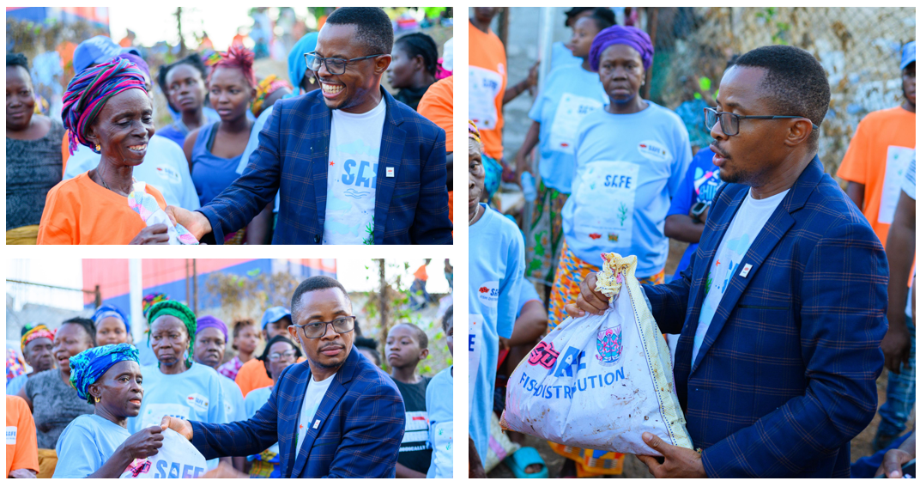
First category of beneficiaries
  University Experimental Primary School, Tikonko = 2,500 kg
  Every Nation Academy Primary School = 4,000 kg
  University Experimental Primary School, Njala = 3,000 kg
  United Methodist Primary School, Bonganeme = 835 kg
  Bo Government Hospital Nutrition Department: 1,250 kg
  Vulnerable Groups (pregnant women, elderly, single mothers): 13,415 kg

Slide 16
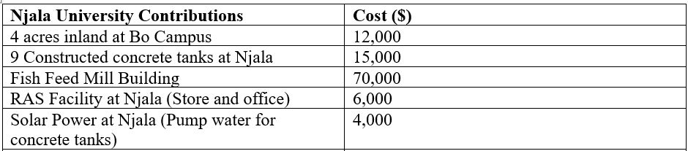
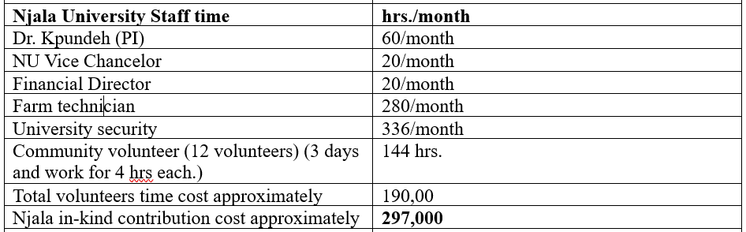
Njala University Contribution to OSU-NU SAFE Project

Slide 17
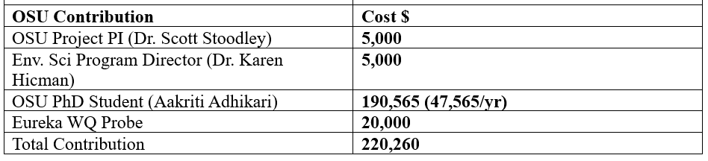
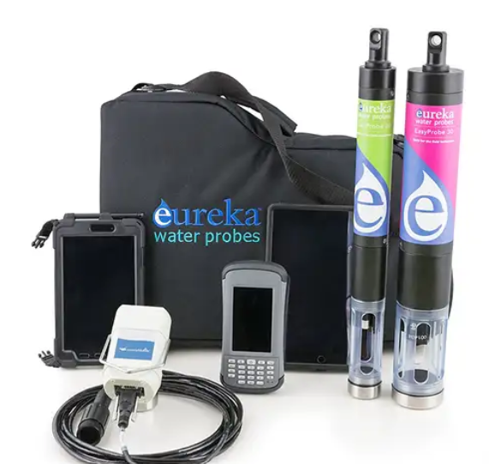
OSU Contribution to OSU-NU SAFE Project

Slide 18
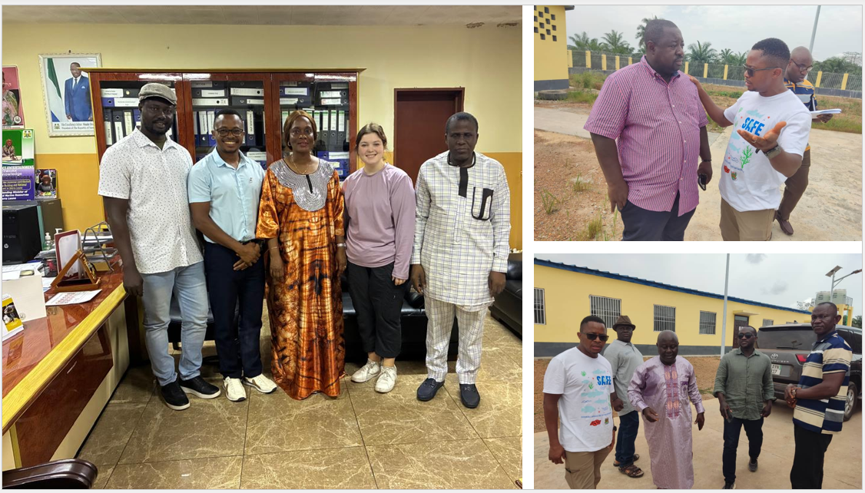
Funding collaboration effort
Ministry of Agriculture: Feed Salone-Grant
Ministry of Fishery and Marine Resources to collaborate on joint proposal-World Bank
Food System Resilience Program: World Bank
Small Grant Funds: UNDP

Slide 19
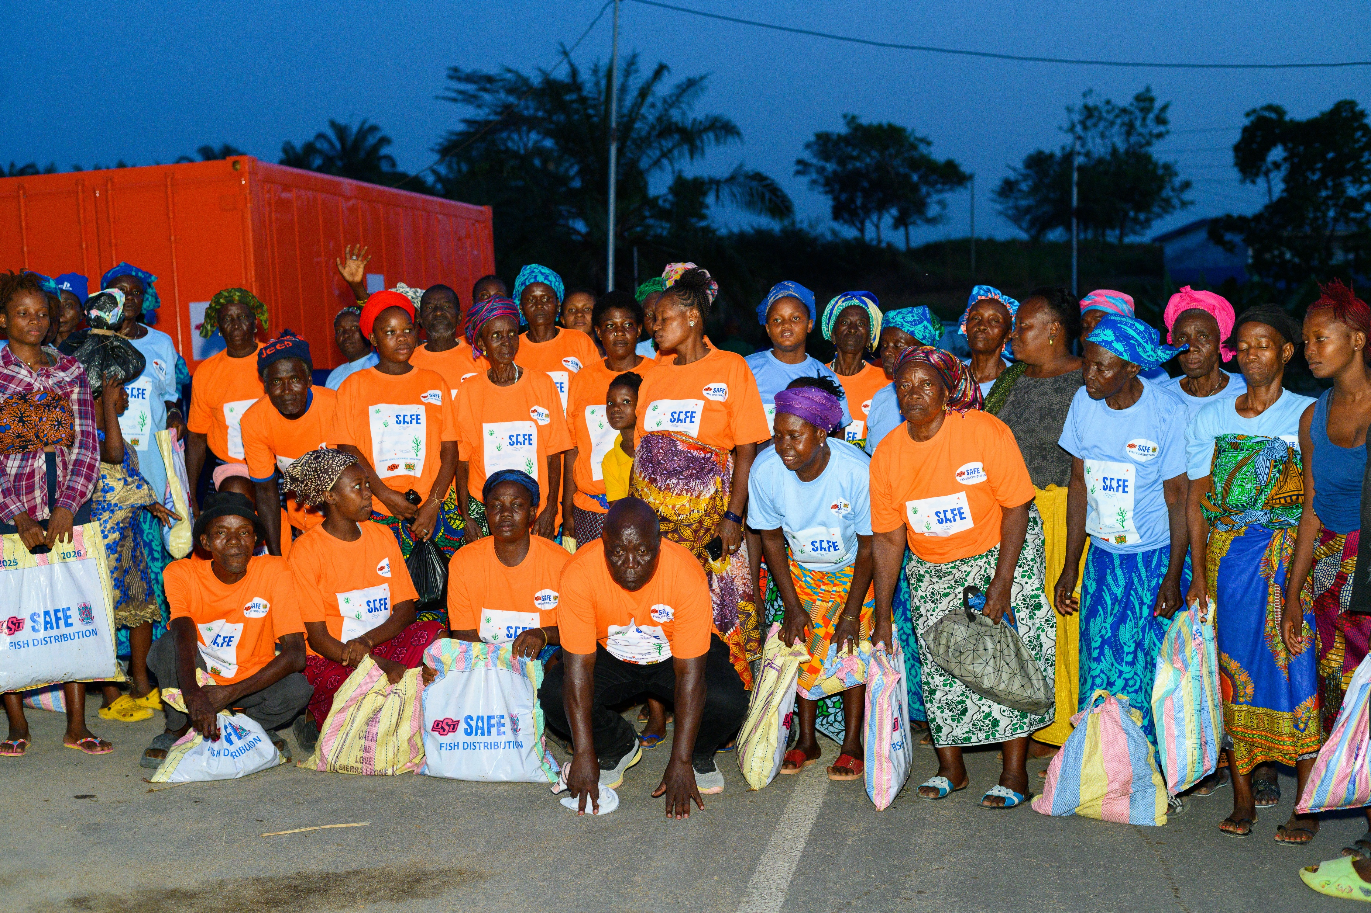

Slide 20
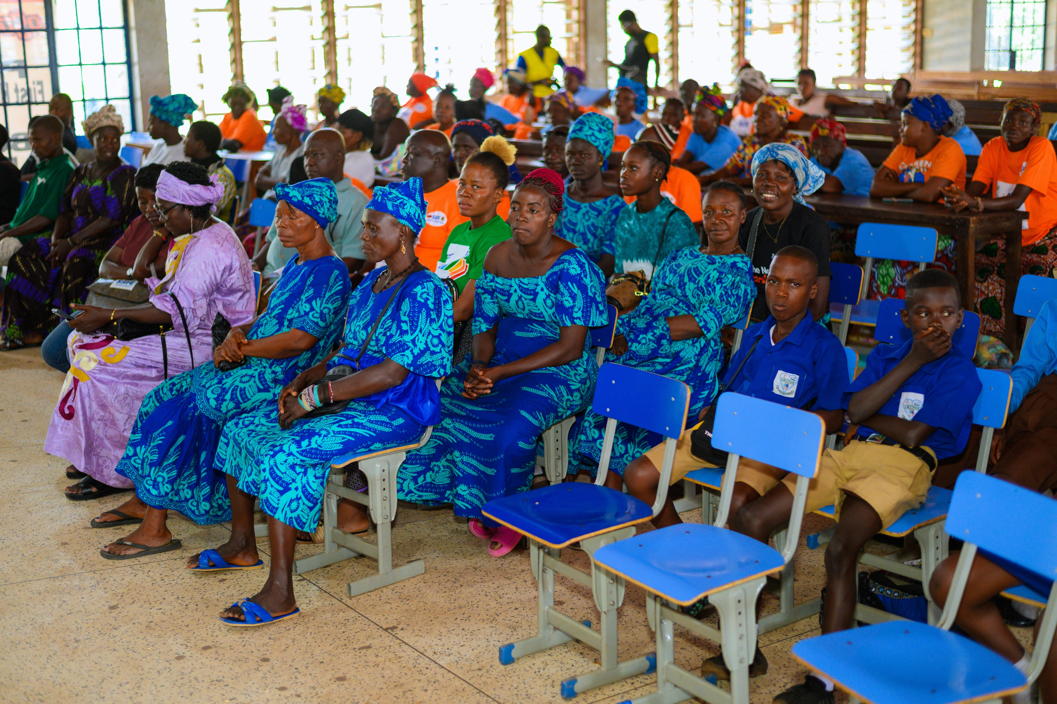

Slide 21
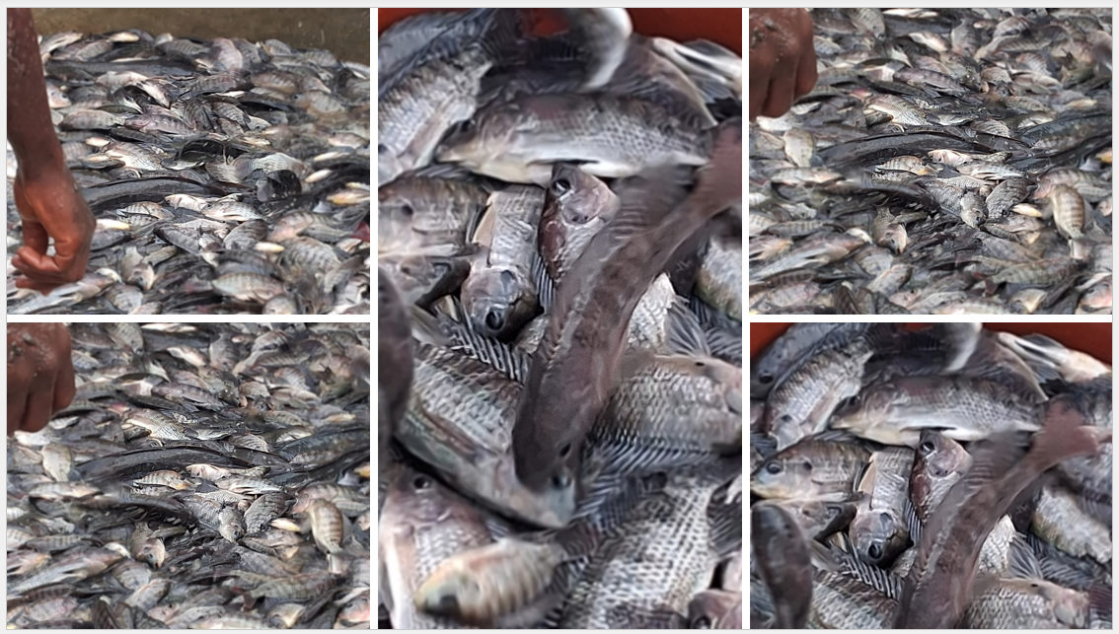

Slide 22
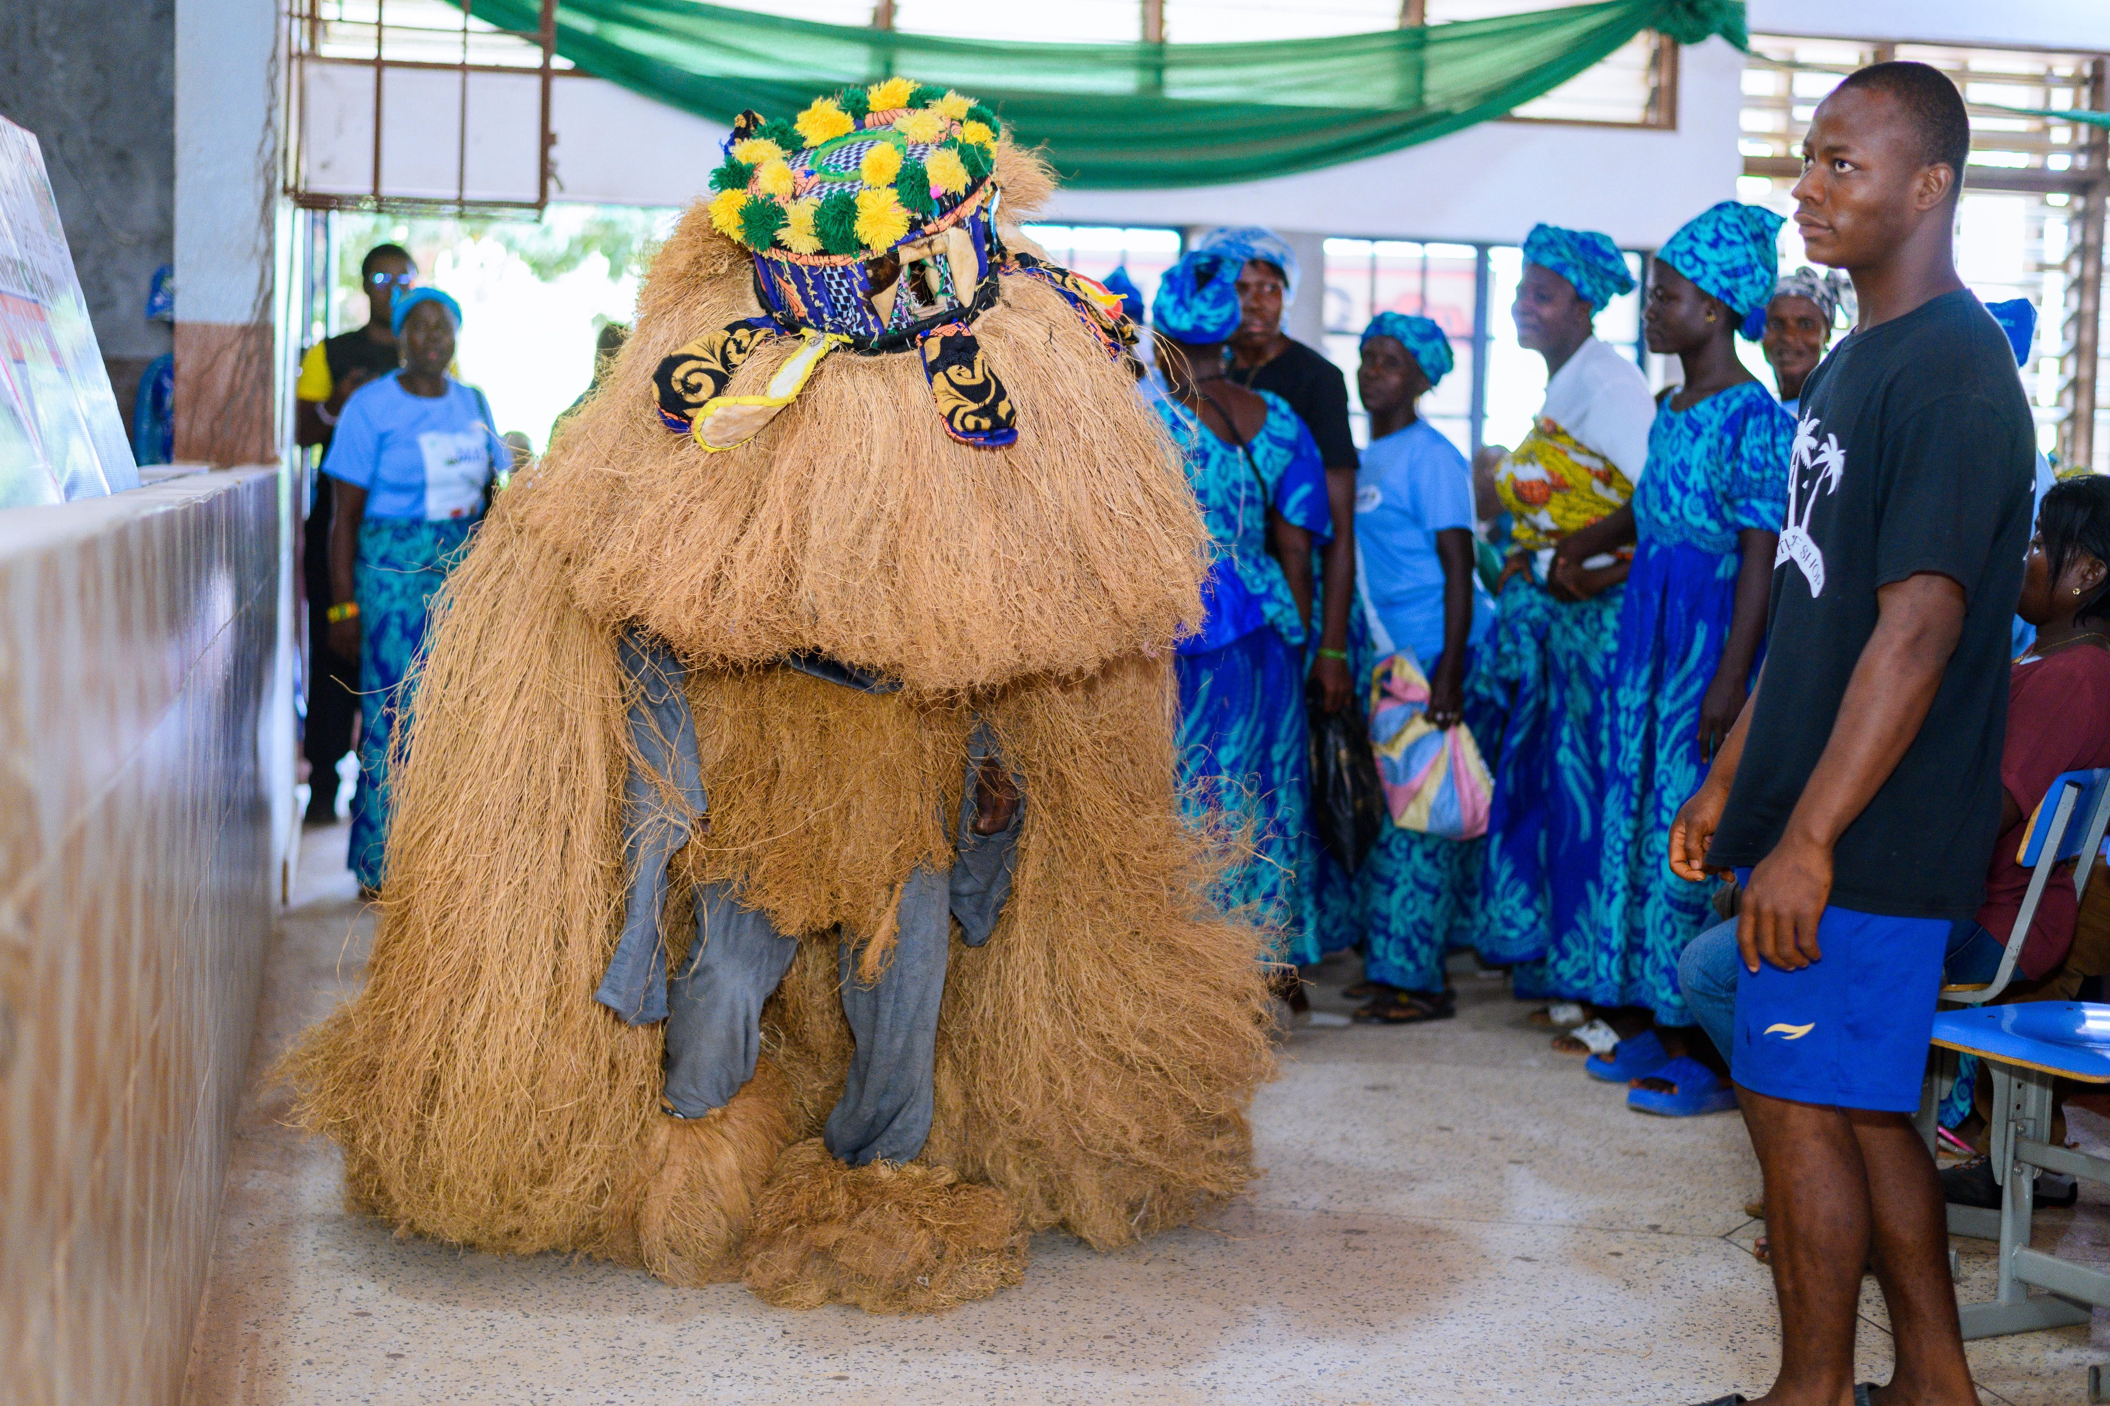

Slide 23
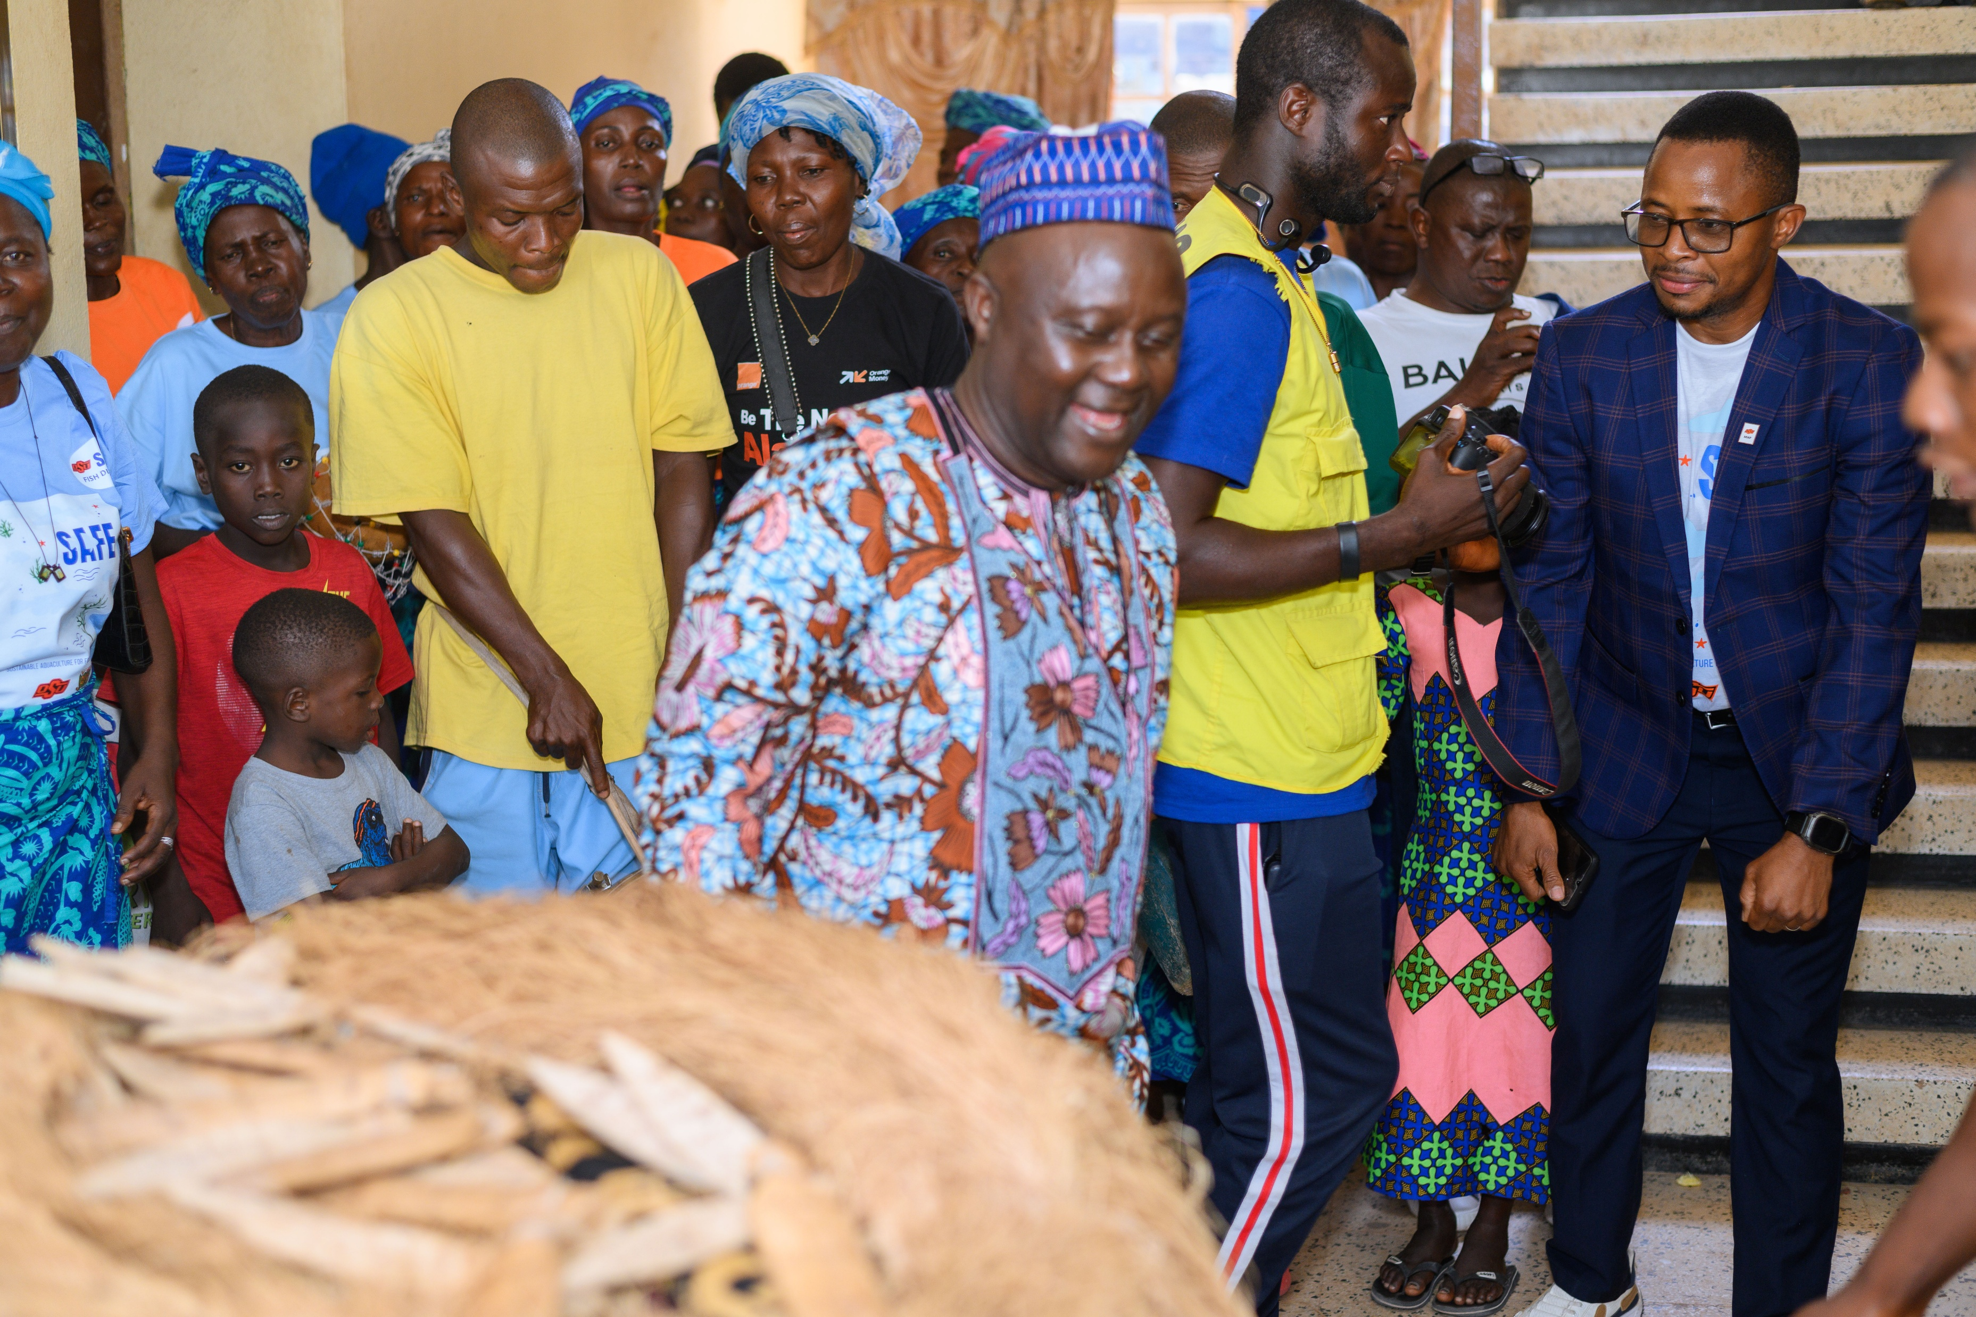

Slide 24
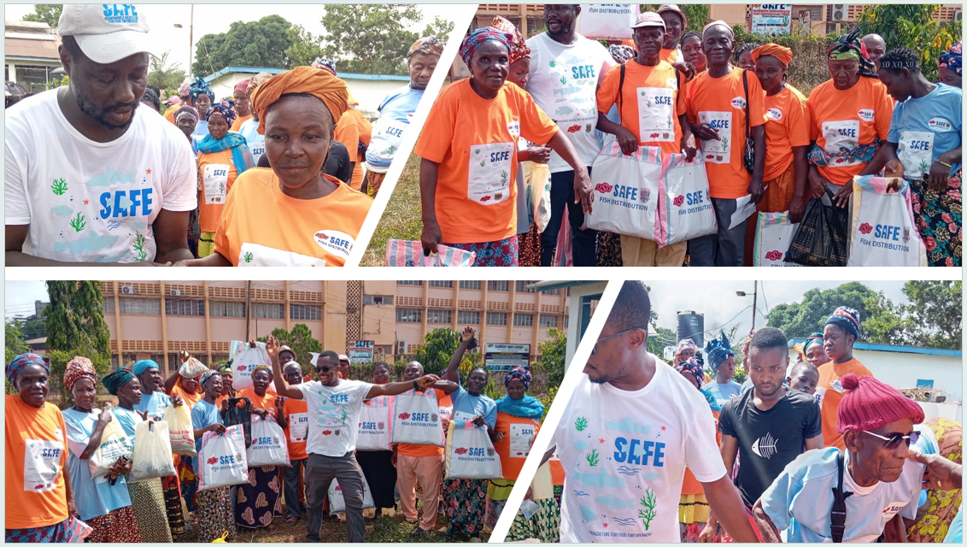

Slide 25
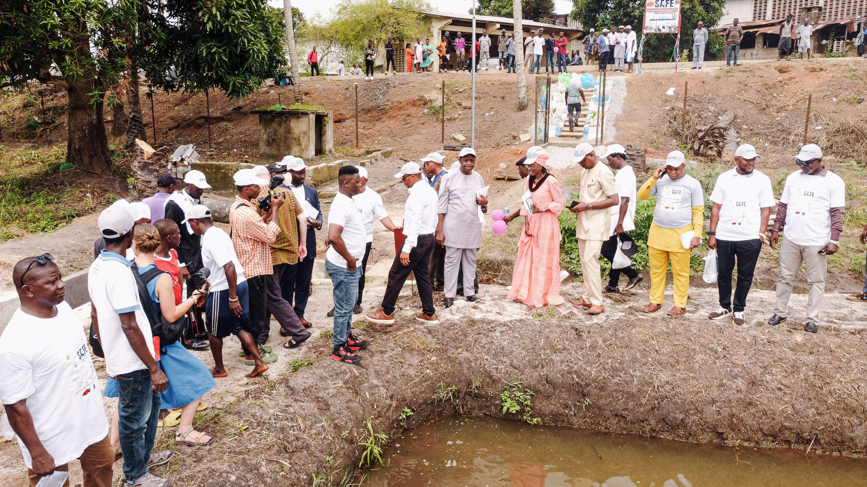

Slide 26
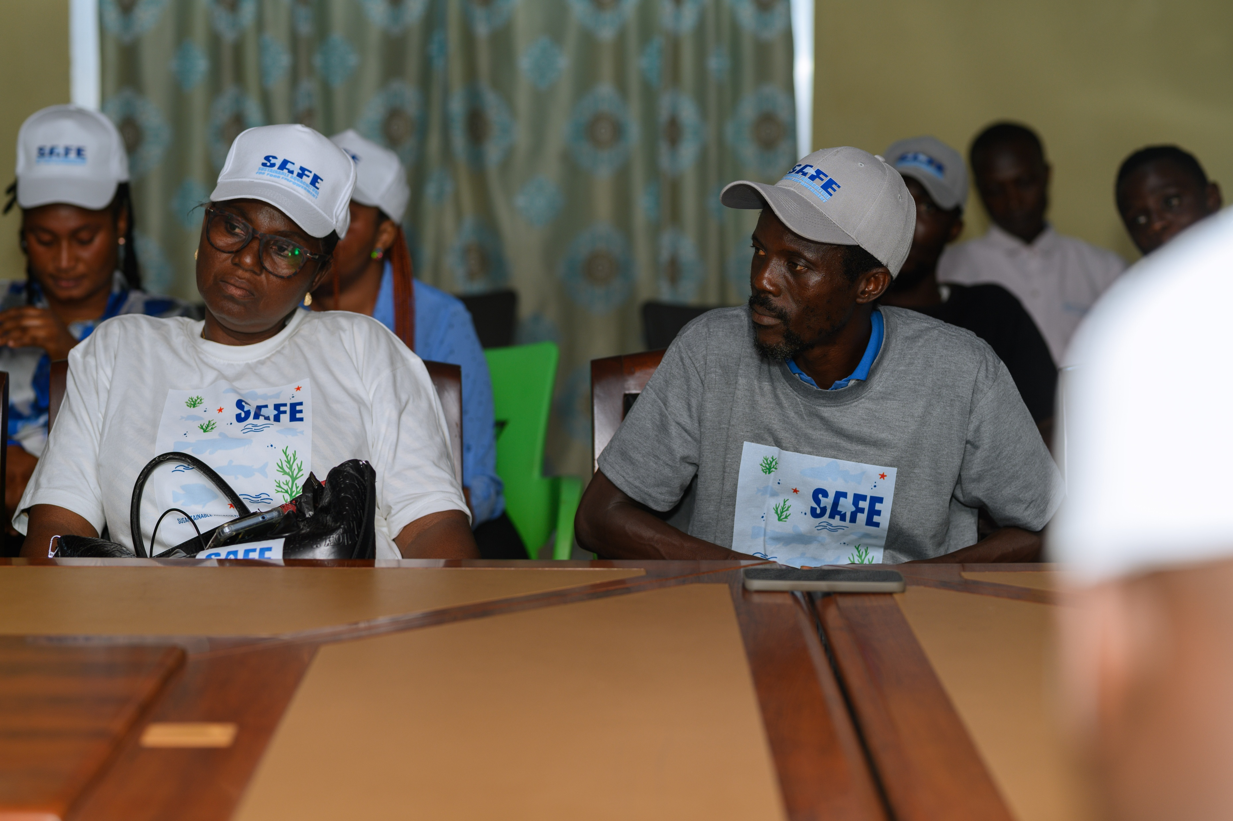

Slide 27
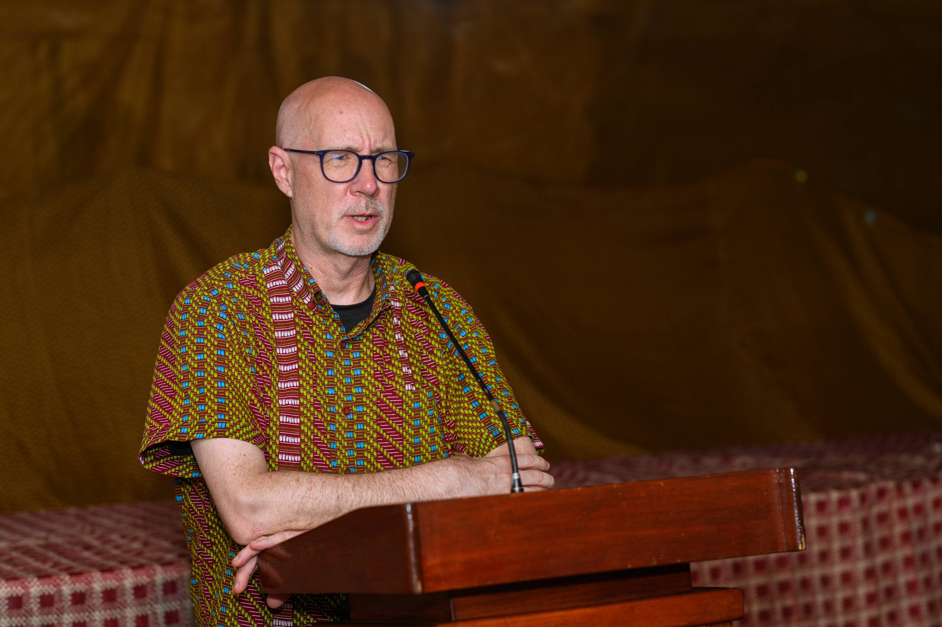

Slide 28
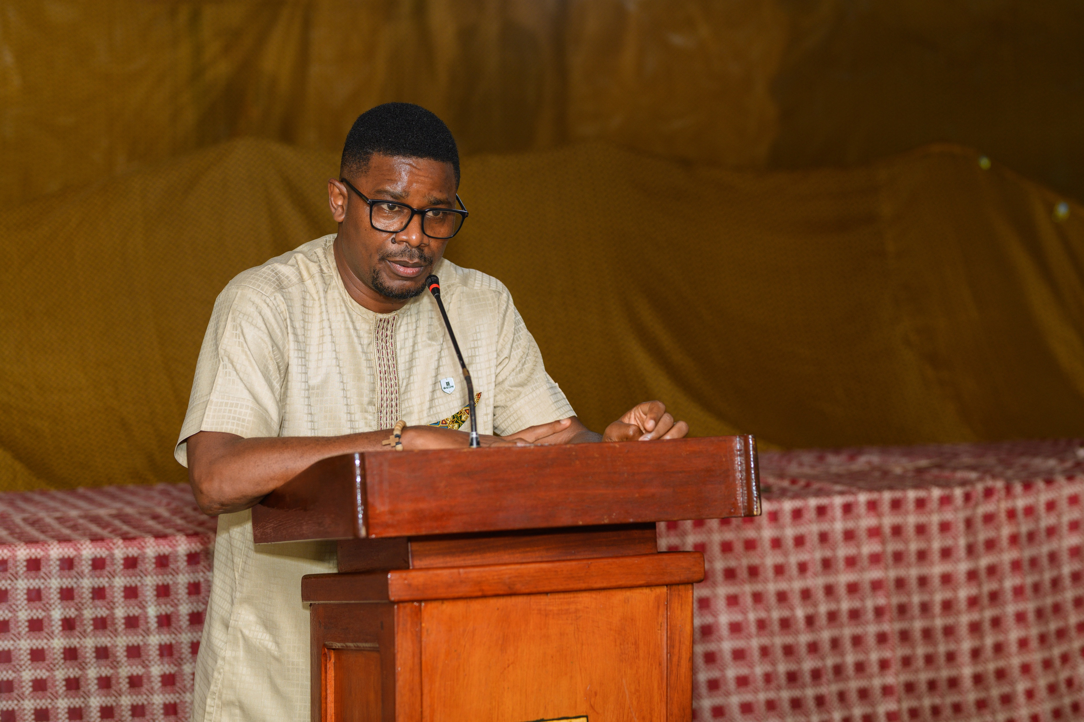

Slide 29
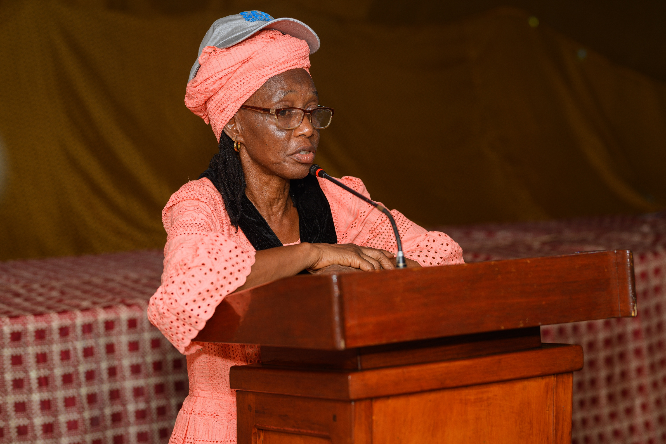

Slide 30
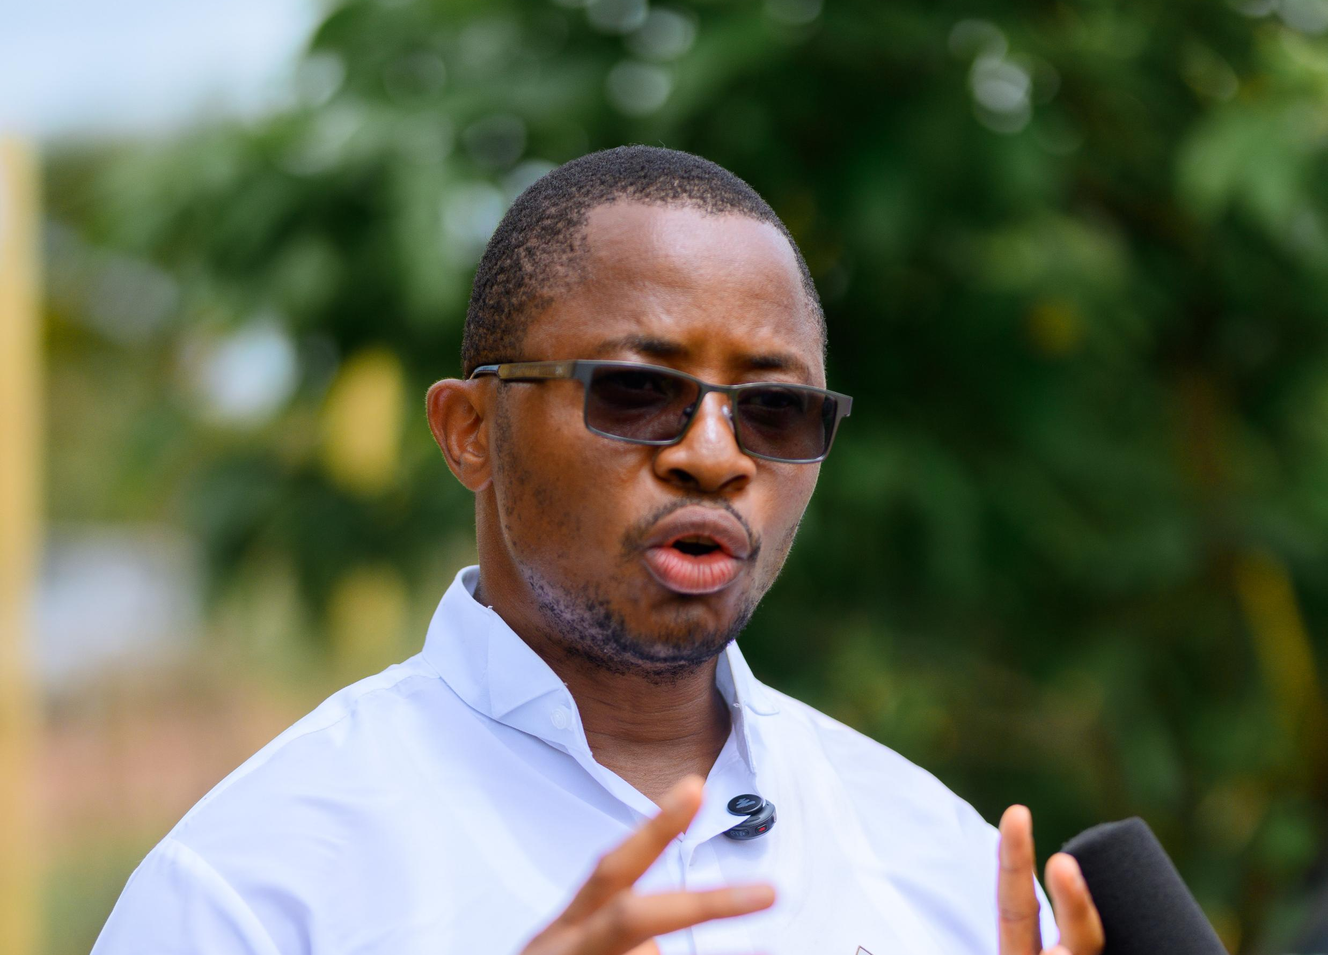

Slide 31
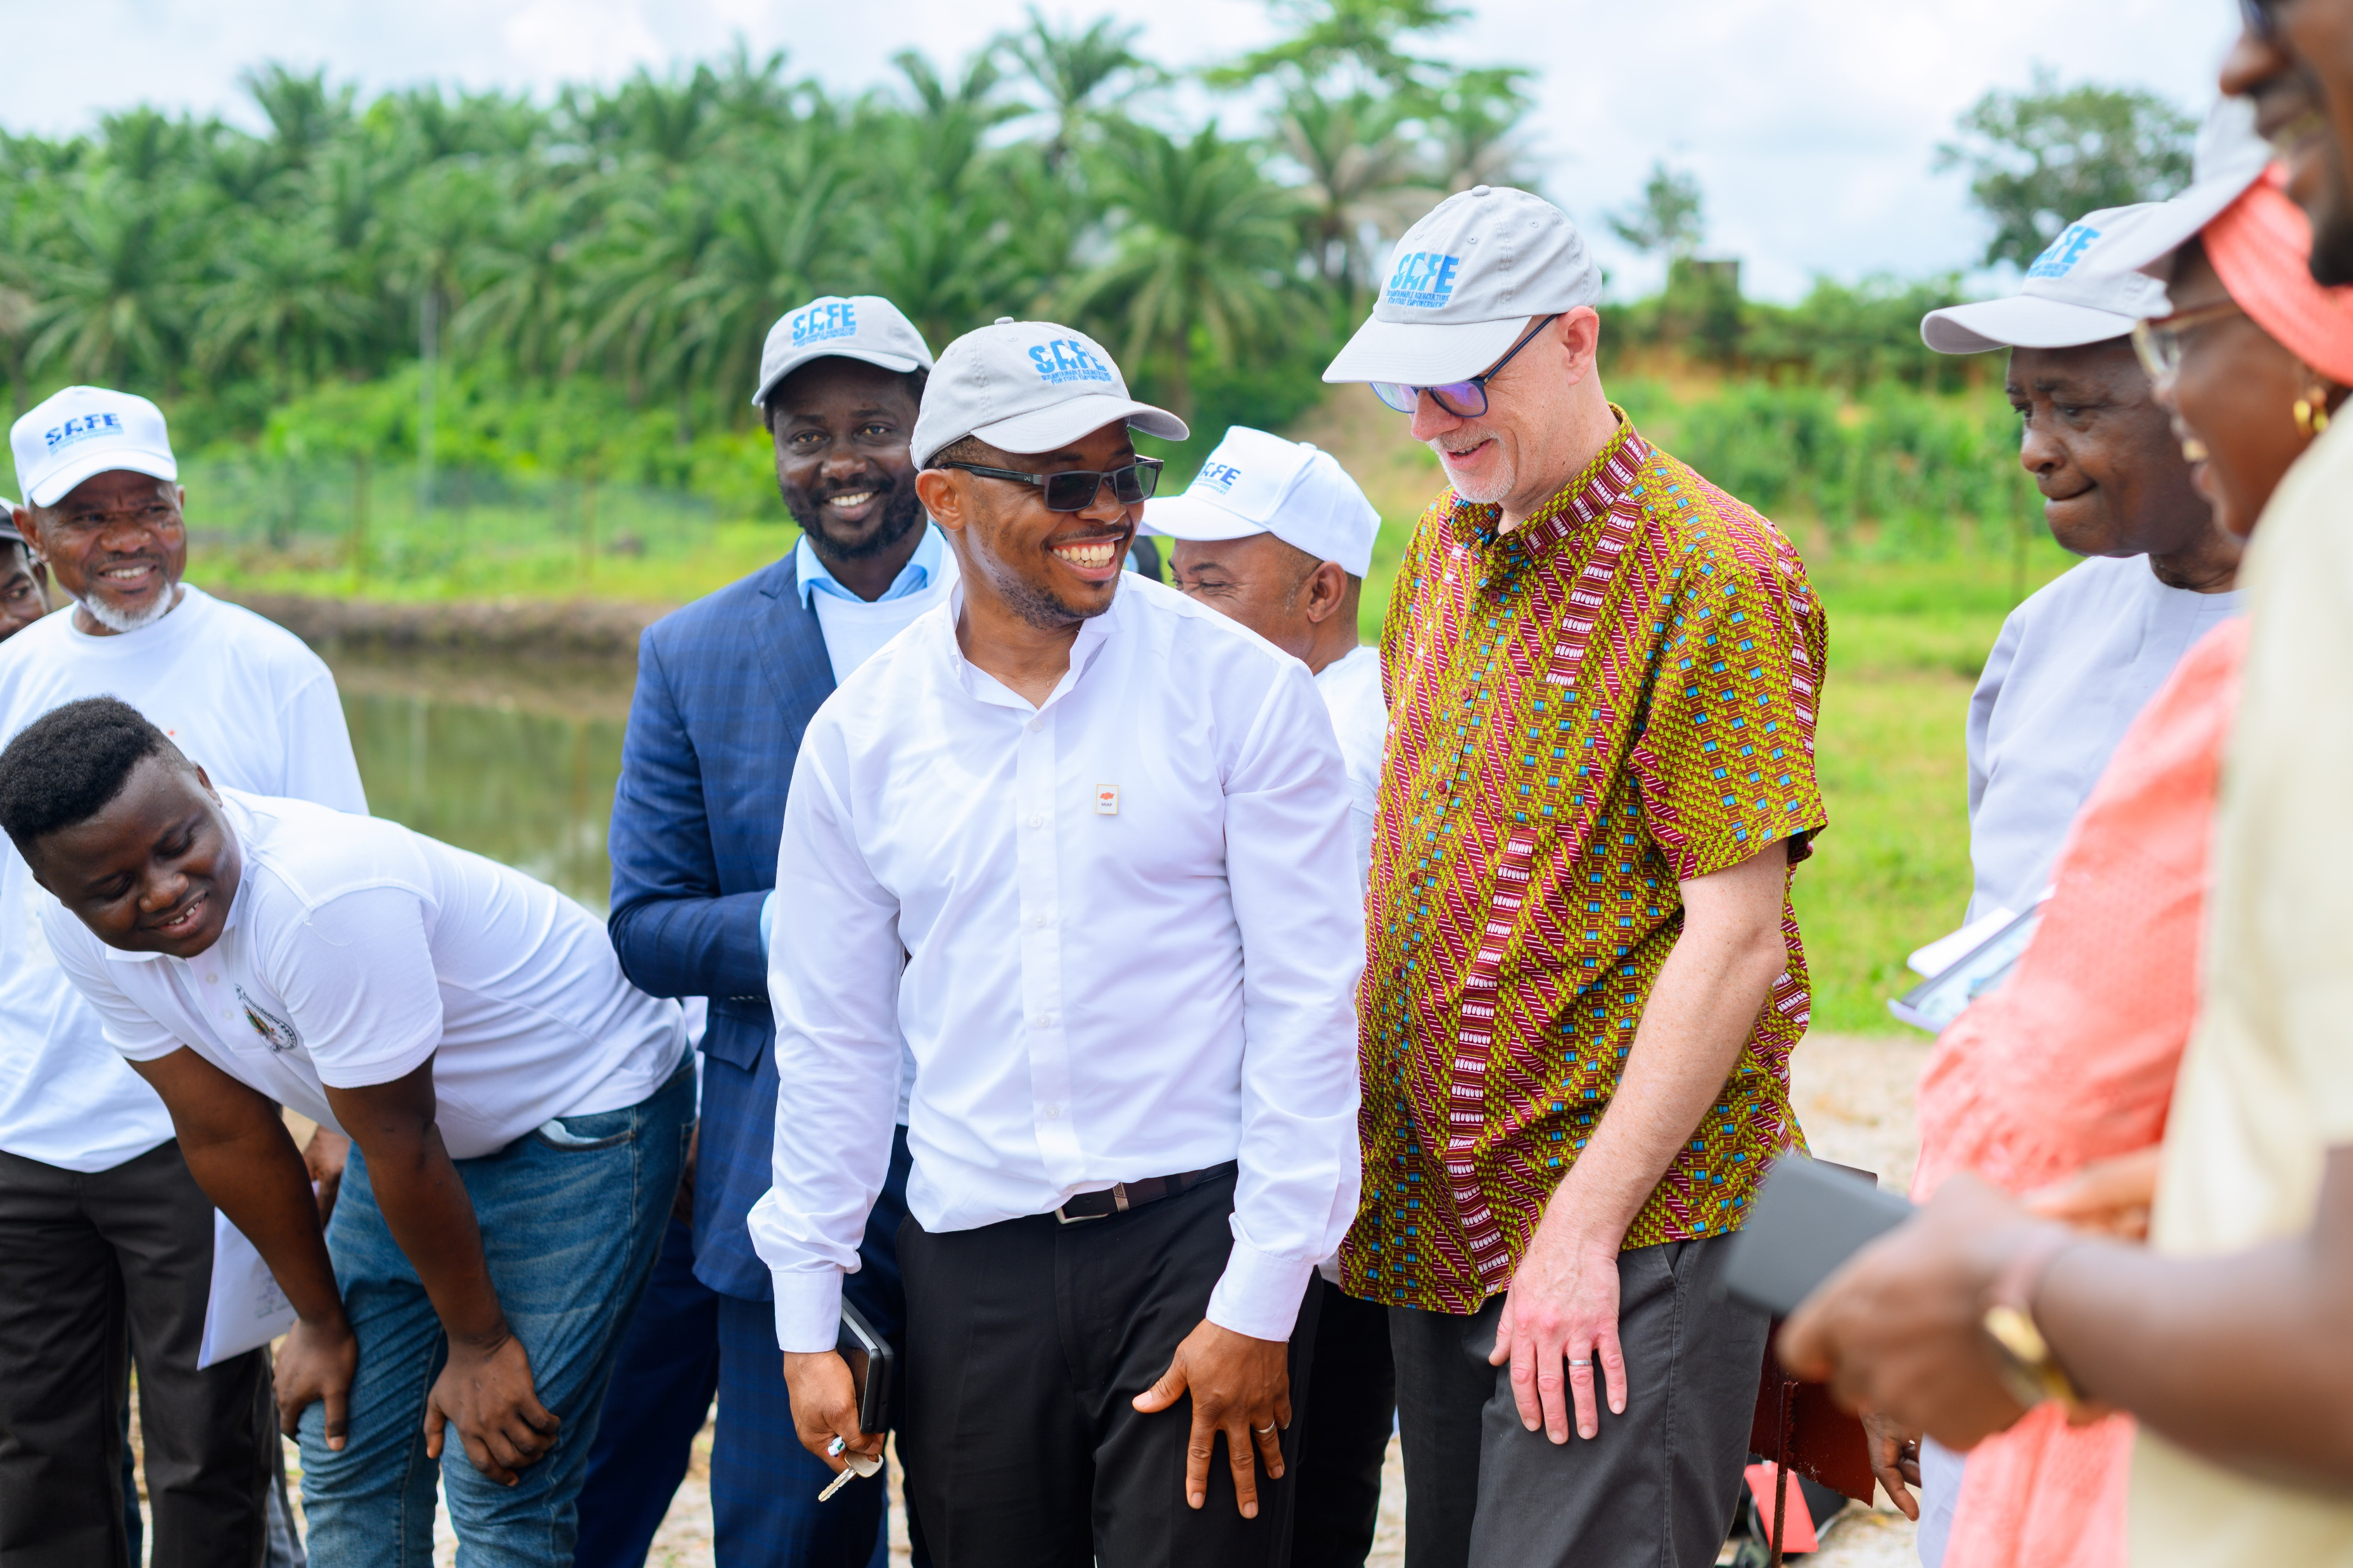

Slide 32
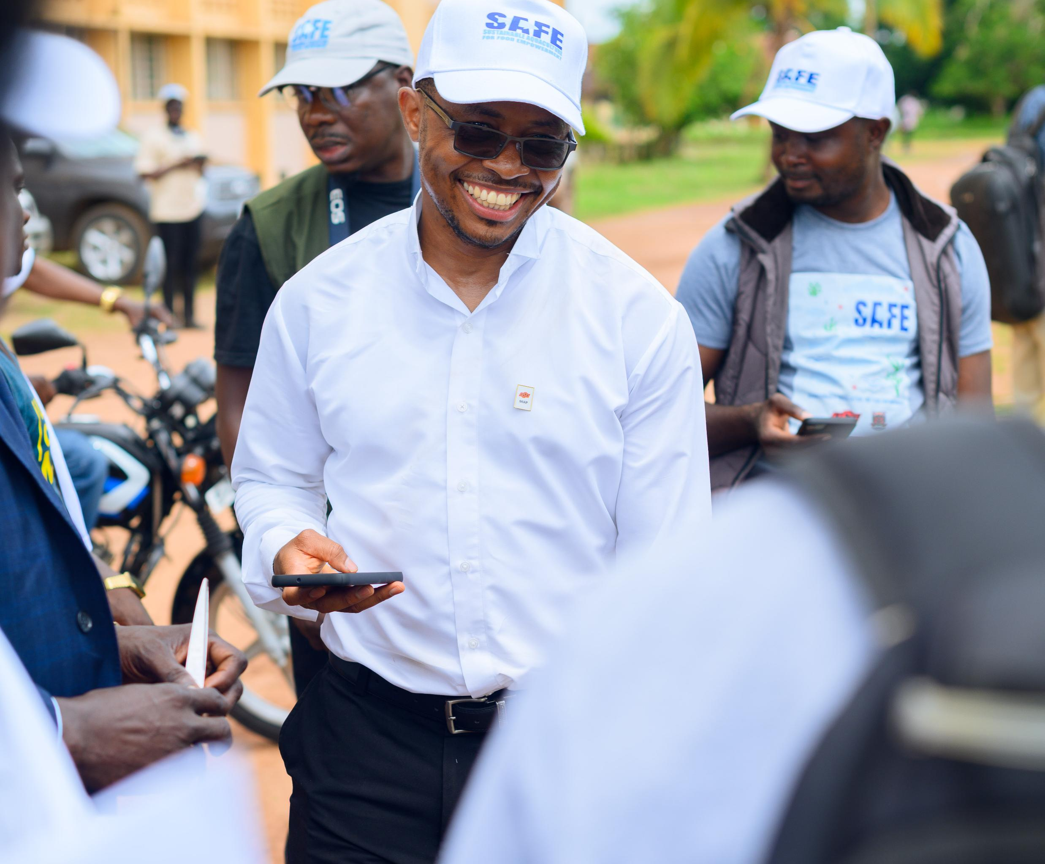


Slide 33
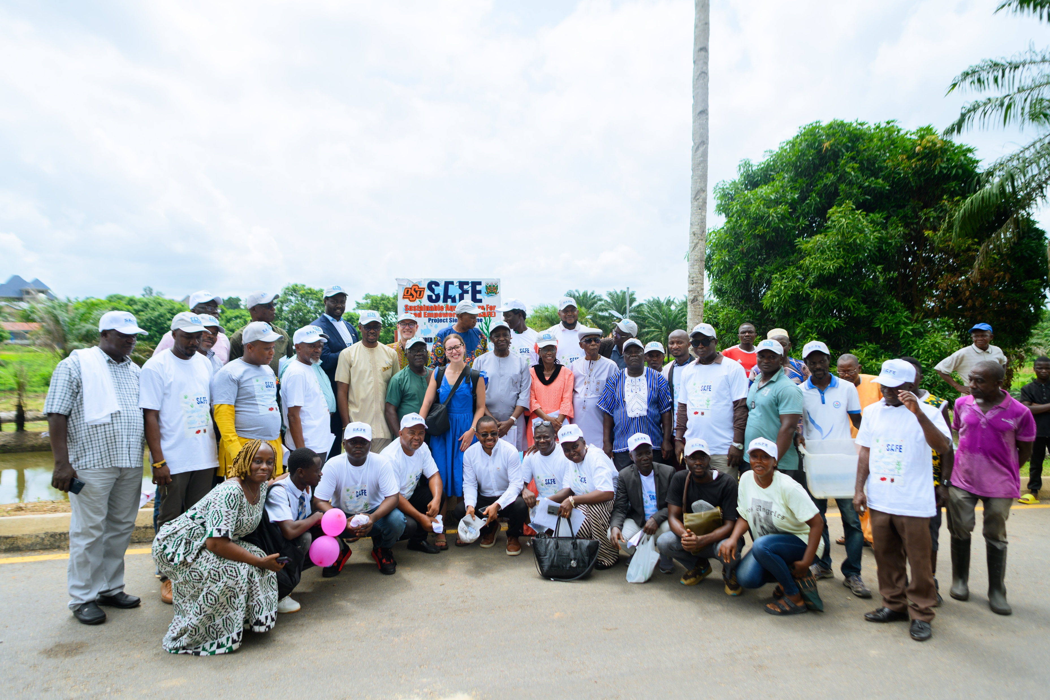

Slide 34
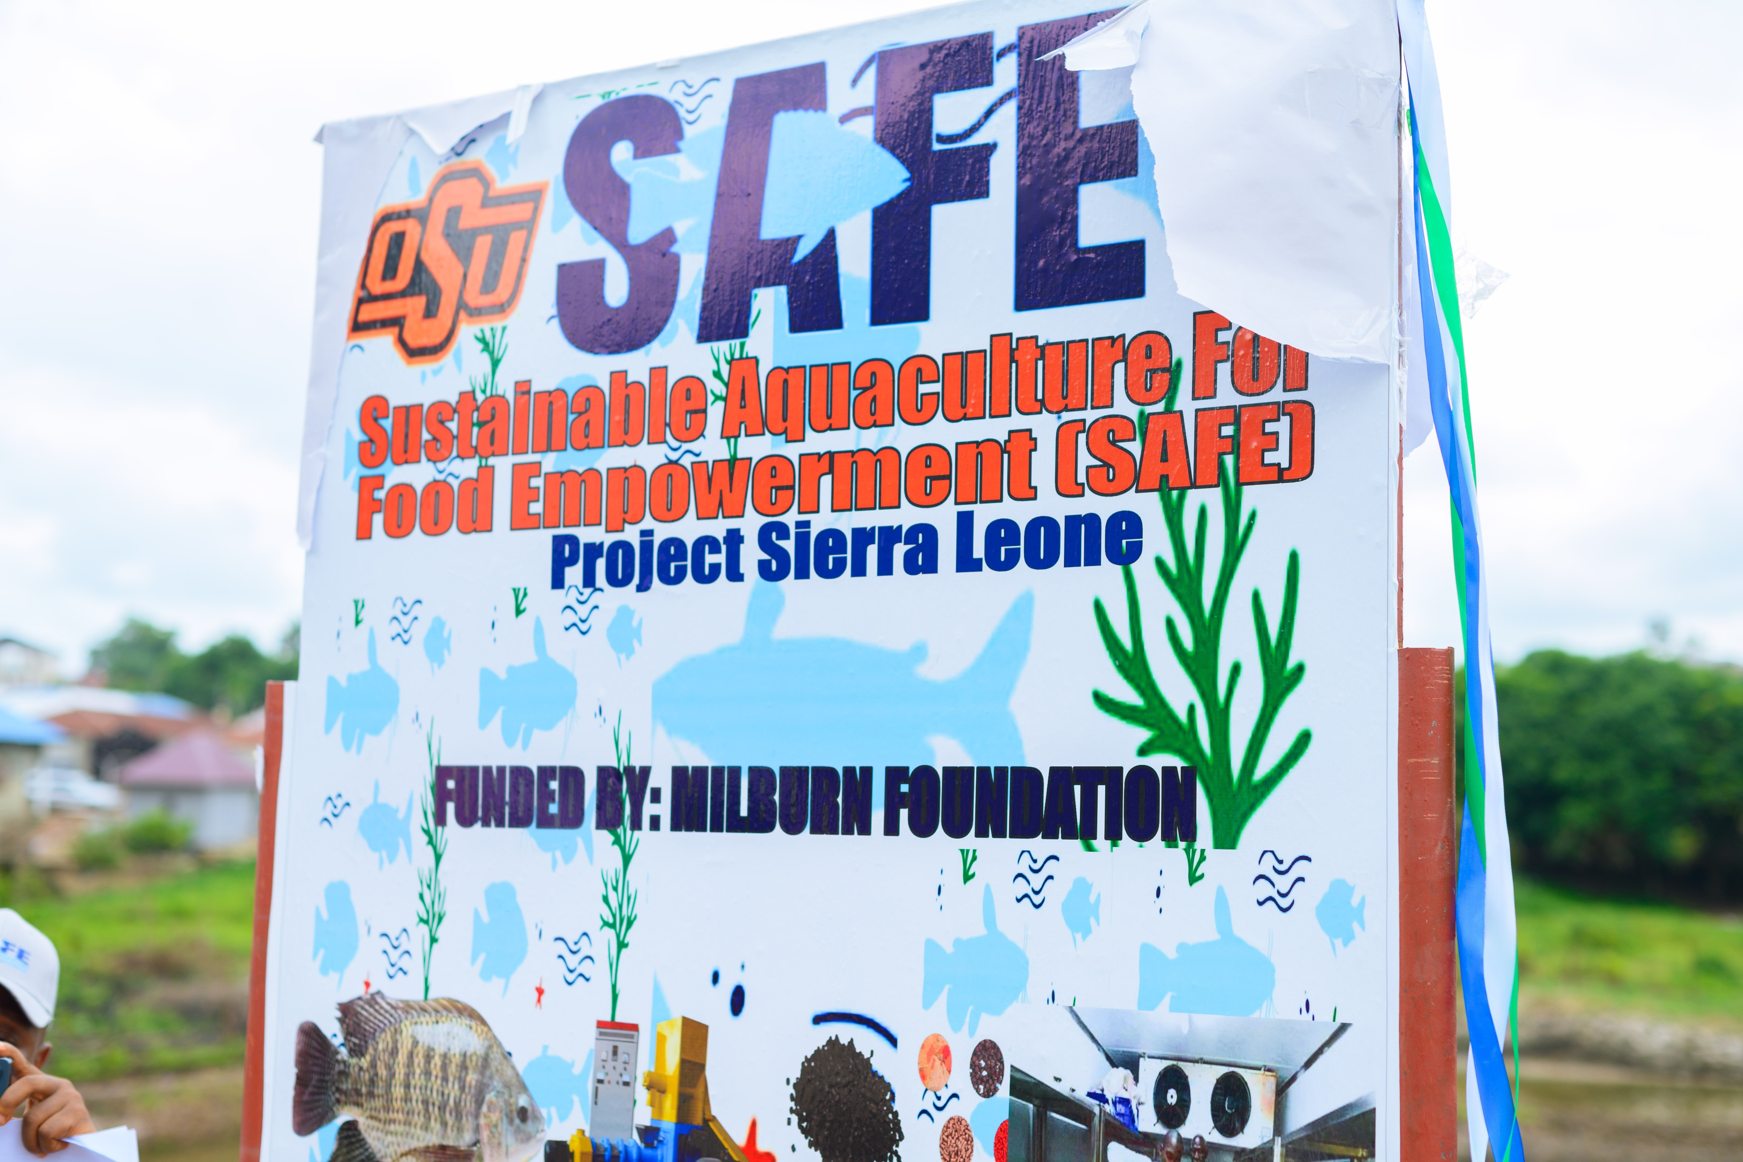

Slide 35
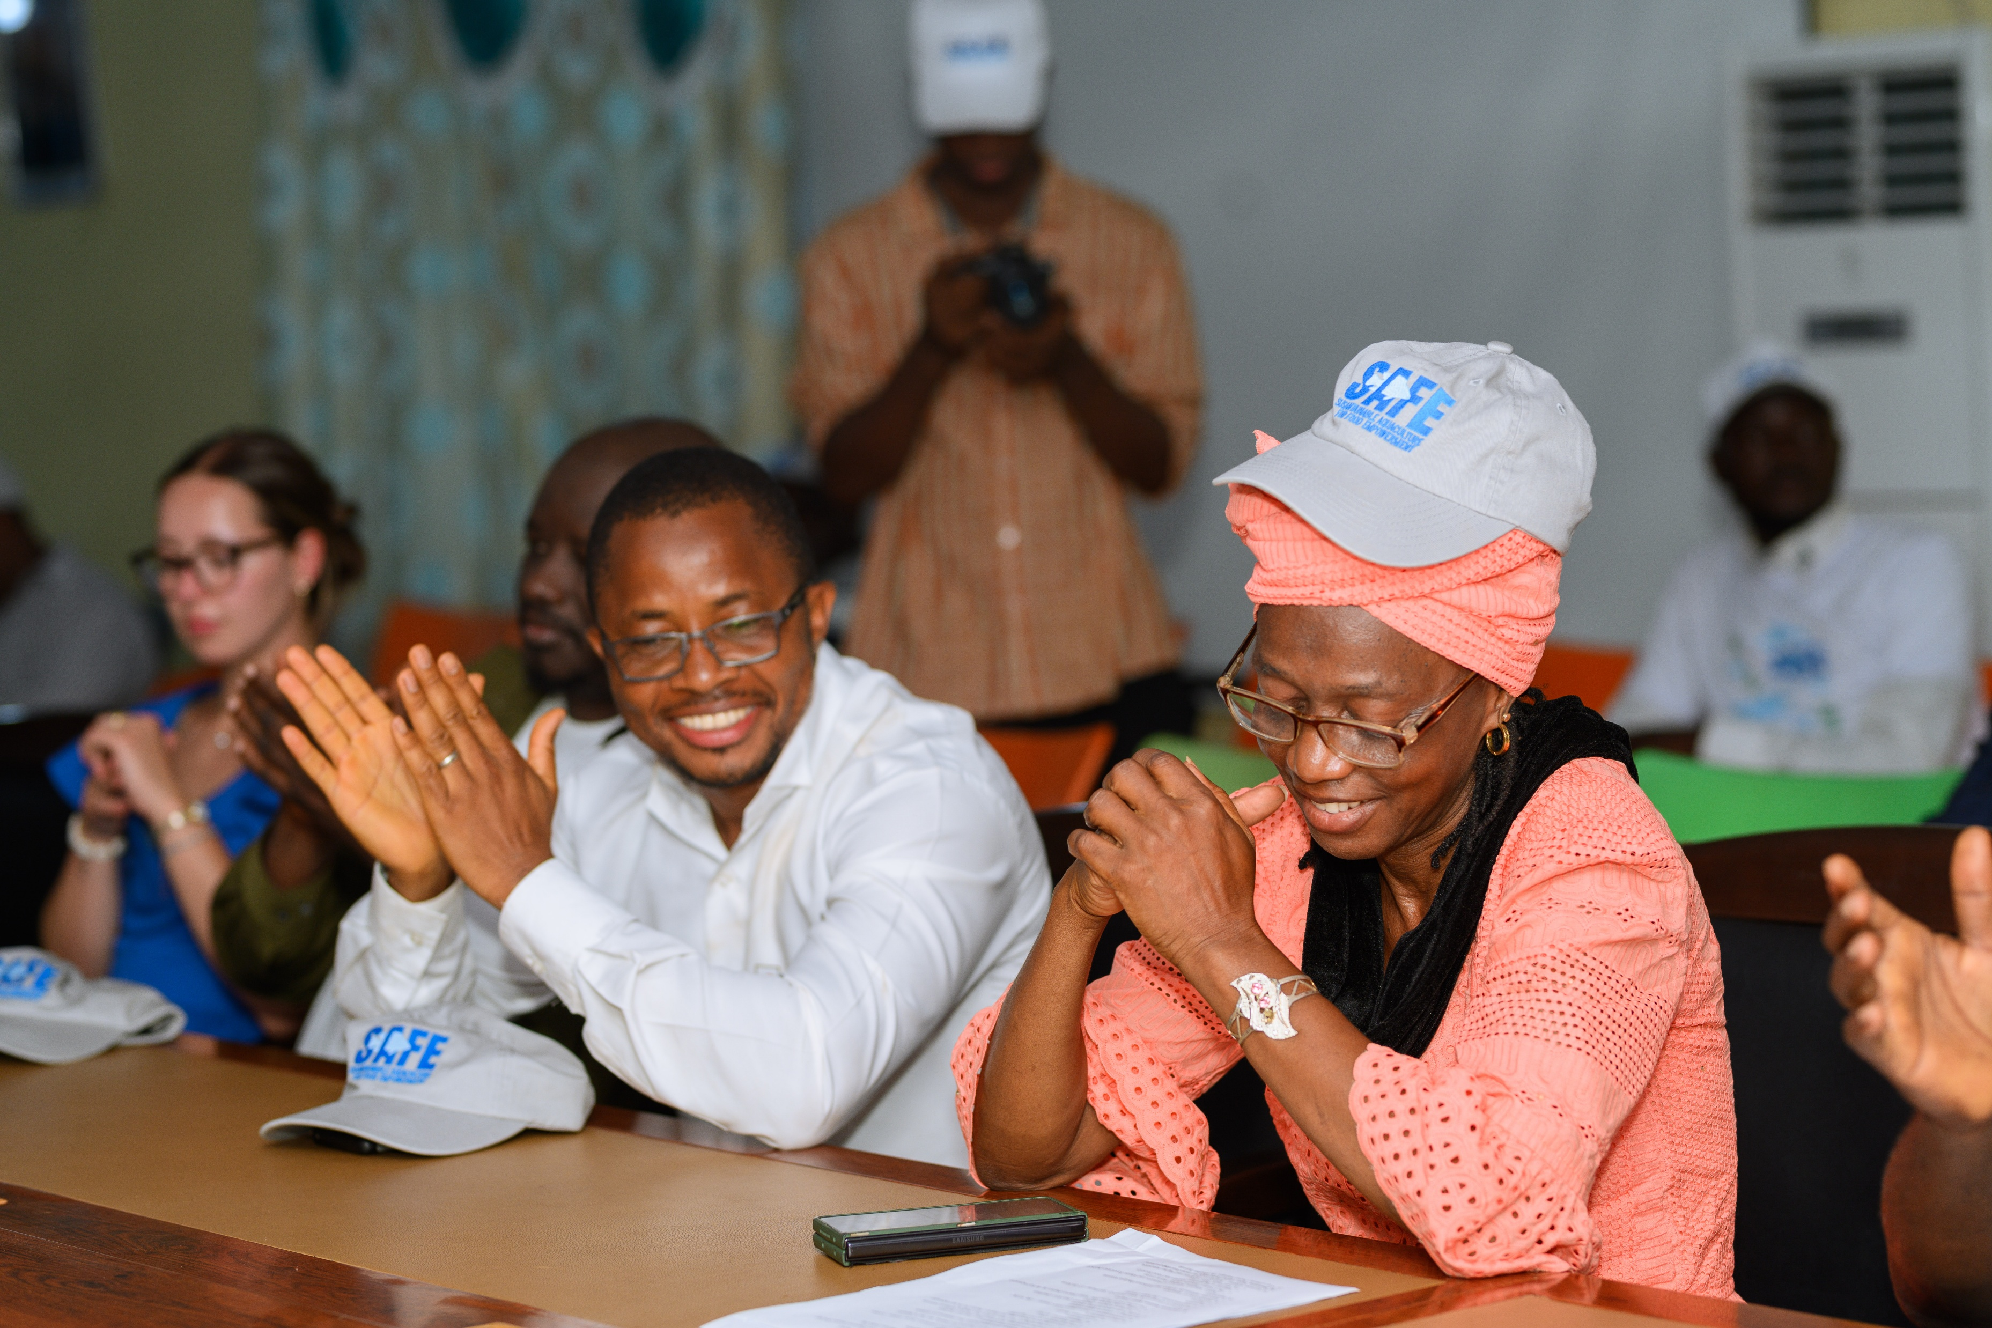

Slide 36
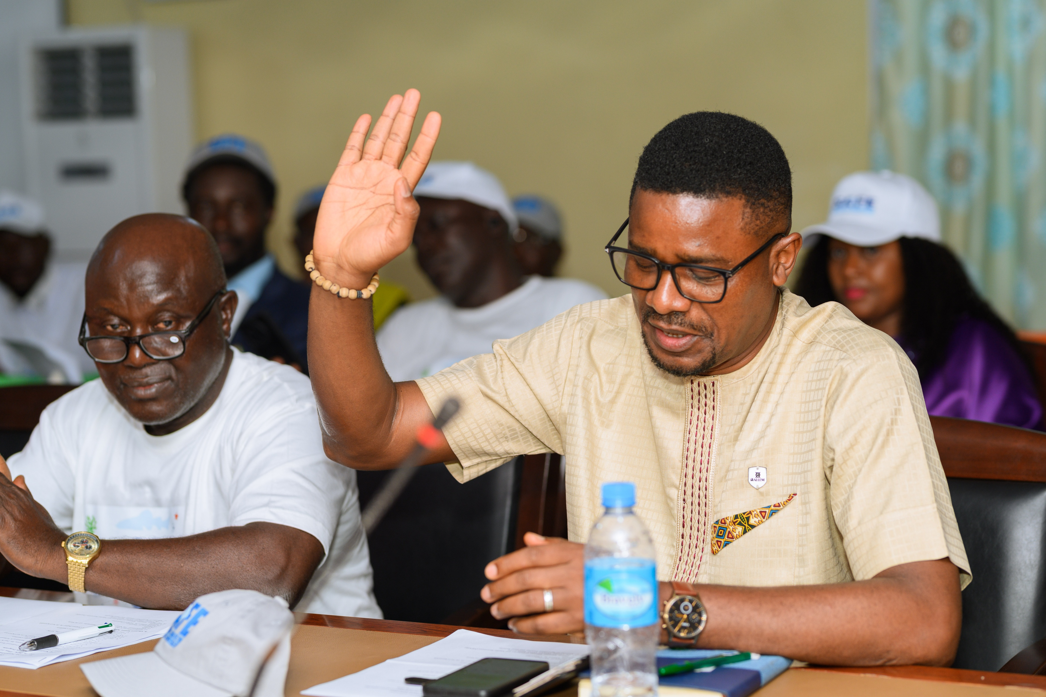

Slide 37
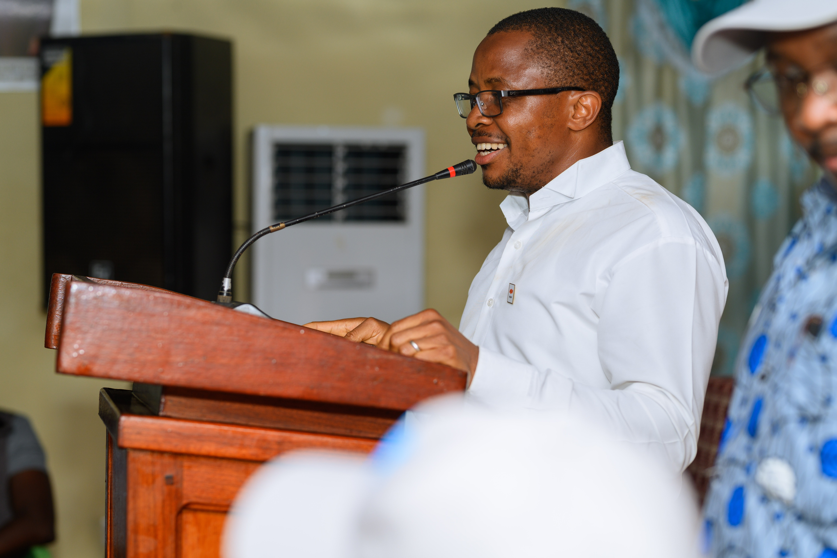

Slide 38
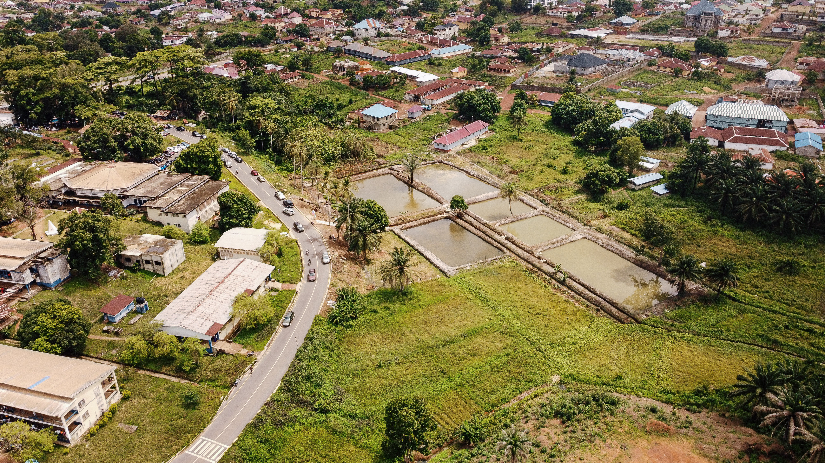

Slide 39




Acknowledgments

Slide 40


ANY QUESTIONS?
THANK YOU

Slide 41

References
https://www.worldfishing.net/detained-trawlers-abscond-from-sierra-leone/1256697.article
https://fishfarmforum.com/harnessing-genetics-to-improve-tilapia-health-and-performance/
https://thehungryjpeg.com/product/4093590-cartoon-money-bag-dollar-cash-stack-and-gold-coins-bundle-of-banknot

