Slide 1
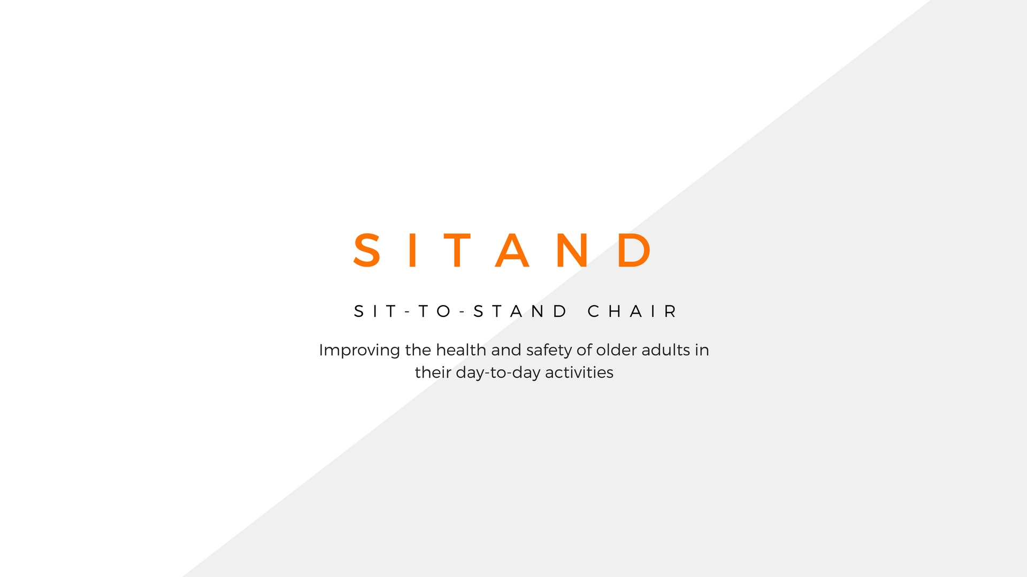
Principal Investigator: Andre Ferreira | Entrepreneurial Lead: Tilanka Chandrasekera and Aditya Jayadas
Industry Mentor: Margaret Slevijan

Slide 2

Business thesis
My Team, ”Team Sitand” is developing a chair
to help older adults
move from the sitting position to standing position much easier which will reduce hospitalization and health conditions arising from issues with spinal injury.

Slide 3
Interview summary
42 individuals were interviewed(manufacturers/designers, older individuals (65 and above) and younger individuals were interviewed)
The individuals were interviewed face to face, through video conferencing and Telephone.
The individuals resided in Houston, TX, Dallas, TX, Pheoniz, AZ, Tulsa, OK, Stillwater-OK, Colombo-Sri Lanka, London-UK, Kerala-India, Sao Paulo-Brazil.
There were regional differences in the responses provided.

Slide 4
Interview summary
IFMA WWP collected data from 3 interviews
Industry specific standards were discussed.

Slide 5
Business Model Canvas
Key Partners Retails stores Health Care and assisted care industry partners Interior designers and architects Furniture Manufacturers | Key Activities Relationships with furniture manufacturers Relationships with assisted care facilities | Value Propositions Reduce hospitalization due to spinal injuries Reduce health conditions arising from accidents due to improper sitting conditions Improve comfort by 10% and at a Reduced cost by $100 compared to competitors |  | Customer Relationships Word of mouth Social media Referrals | Customer Segments Older Adults with arthritis and osteoporosis Juvenile arthritis Assisted Care living facilities Bariatric Individuals
 | Key Resources The lab (The Mixed Reality Lab) Customer lists Manufacturer lists Website |  |  | Channels Website Physical
Cost Structure Website Marketing |  |  | Revenue Streams Revenue from purchases Revenue from maintenance

Slide 6

HYPOTHESIS 1
H1: Older adults will find the furniture piece helpful in their daily activity
Experiment: interviews with older adults will be conducted
Tested. Null hypothesis rejected.

Slide 7
HYPOTHESIS 2
H2: Furniture manufacturers are willing to manufacture a chair that helps older adults stand easily after sitting down. Furniture manufactures will be interest in this technology because of the lack of similar effective products.
Experiment: interviews with furniture manufacturers will be conducted
Tested. Null hypothesis rejected.
We will continue to test this hypothesis

